Slide 1
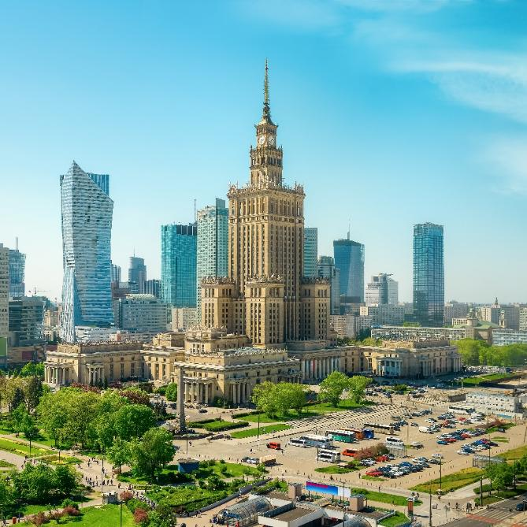
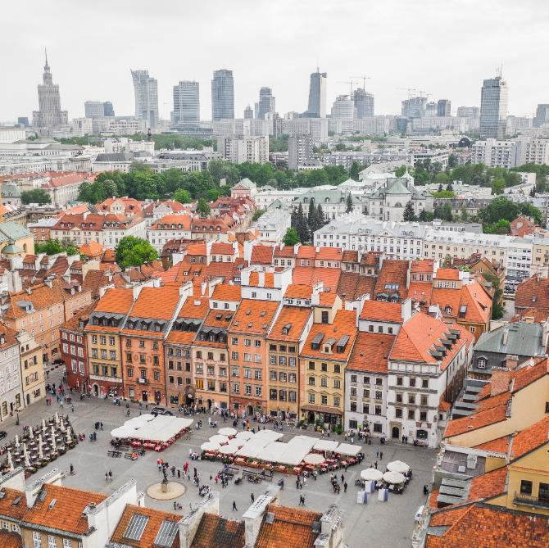
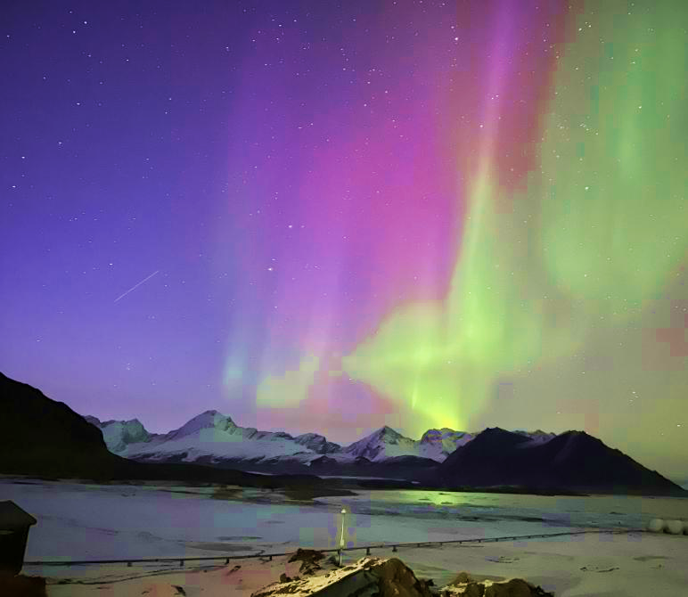
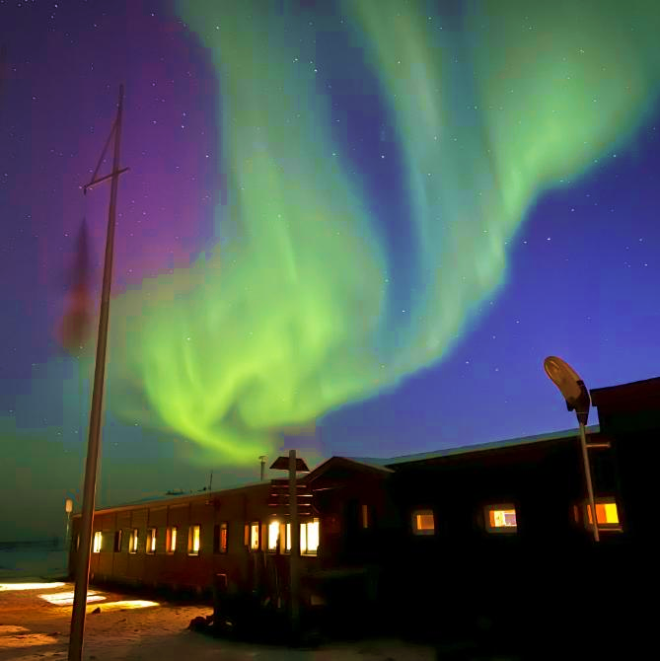
IAG/ IAGA Joint Assembly 2029
Presentation of Polish bid
on June 18, 2026
August 19-24, 2029
University of Warsaw, Warsaw, Poland
International Association of Geodesy/ International Association of Geomagnetism and Aeronomy

Slide 2
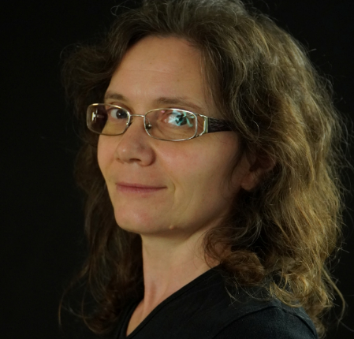
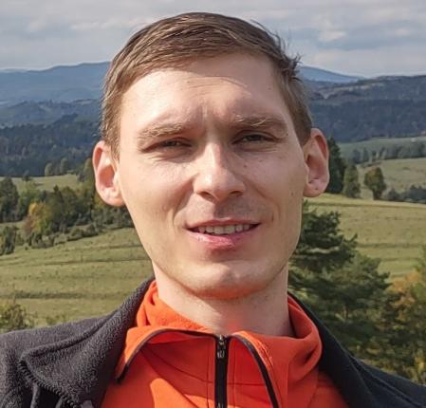
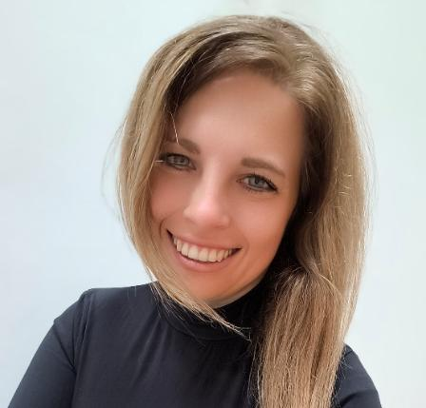
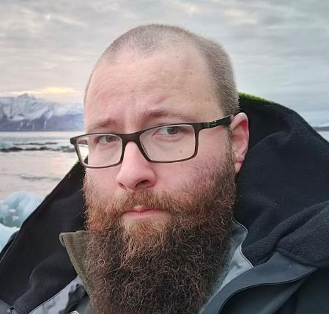
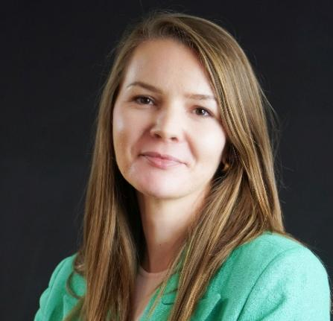
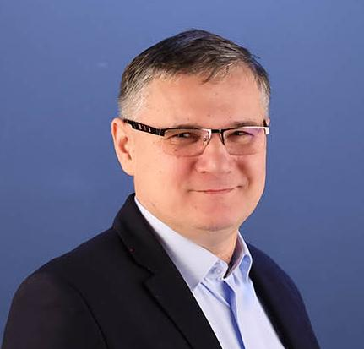
Local Organizing Committee
IAGA
Anne Neska - Institute of Geophysics Polish Academy of Sciences, Chair
Specializes in magnetotellurics, ground-based geomagnetic observations, and Schumann resonance monitoring, and serves as the incoming Co-Chair of the IAGA Div VI Division Committee as well as Co-Editor-in-Chief of the scientific journal Acta Geophysica.
Paweł Jujeczko - Space Research Centre
of the Polish Academy of Sciences
As the lead scientist of the upcoming Polish satellite mission SAWA and principal investigator of the Magnetic Field Device experiment, conducts research based on low Earth orbit measurements of the geomagnetic field and monitoring of magnetophere–ionosphere–thermosphere interactions.
Anna Ejsmont - Institute of Geophysics Polish Academy of Sciences
The lead specialist for the investigation of secular variations in Poland at her Institute and has been responsible for maintaining and modernizing the magnetic control network in Poland, as well as regularly conducting measurements at repeat stations for more than 15 years.
Szymon Oryński - Institute of Geophysics Polish Academy of Sciences
Specializing in electromagnetic methods in geophysics, particularly MT, FDEM, and TEM, conducts research on subsurface structures through their electrical properties. Research focuses on the application of these methods to shallow subsurface, environmental, and glacial studies, often integrating them with other geophysical techniques.
Dominika Niezabitowska-Śliwka - Institute of Geophysics Polish Academy of Sciences
Focusing on Earth’s magnetism, particularly rock, paleomagnetic, and environmental magnetism, combines geology and geophysics to investigate the geological processes that shape sedimentary and mafic rocks. is a member of the International Association of Geomagnetism and Aeronomy Executive Committee (EC).
Zenon Nieckarz - Jagiellonian University Krakow
Conducts research on natural and anthropogenic electromagnetic fields in the ELF/ULF range. Particular emphasis is placed on the magnetic components of Schumann resonances, Pc1/ULF/ELF magnetic pulsations, the propagation of electromagnetic waves in the Earth–ionosphere waveguide, and the influence of solar and magnetospheric activity on the recorded signals.

Slide 3
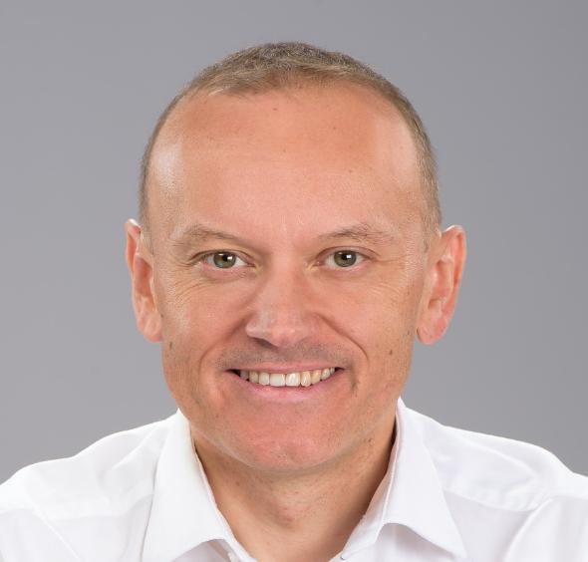
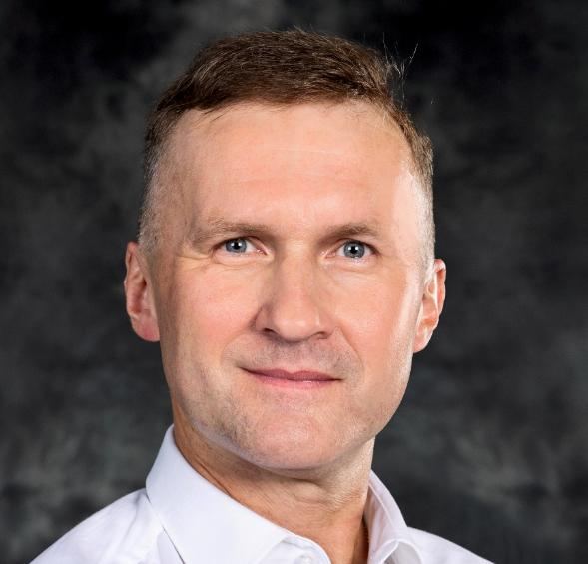
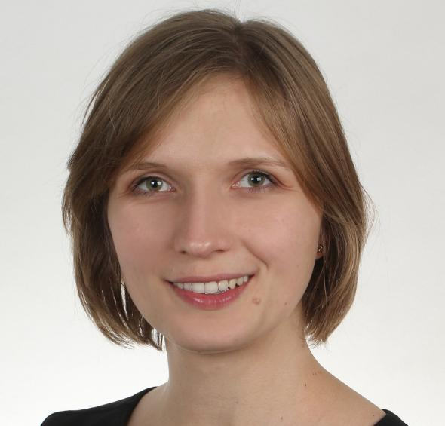
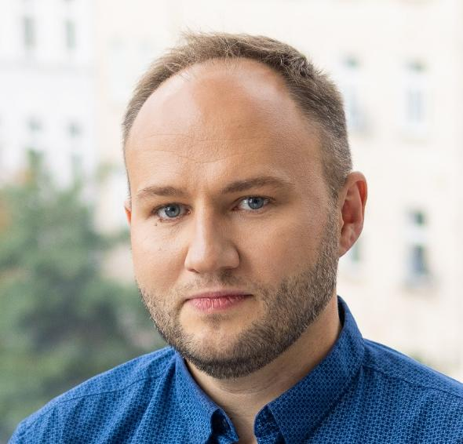
Local Organizing Committee
IAG
Paweł Wielgosz - University
of Warmia and Mazury in Olsztyn,
Co-Chair
President of the International Association of Geodesy Commission 4 "Positioning and Applications". Specialist in satellite geodesy.
Janusz Bogusz– Military University of Technology
Former President of International Association of Geodesy Commission 3 “Earth Rotation and Geodynamics”, with research focused on geodetic time series analysis in physical geodesy and reference frames..
Anna Kłos – Military University
of Technology
Active in the structures of the International Association of Geodesy, including ICCC, GGOS, and ECS representative, with significant involvement in various working groups. Research interests focus on satellite geodesy, particularly GNSS-derived displacements and their applications in hydrogeodesy and climate-related studies.
Krzysztof Sośnica - Wrocław University of Environmental and Life Sciences
Chair of the International Association of Geodesy Sub-commission 1.1: Coordination of Space Techniques, Vice-Chair of the Panel on Satellite Dynamics (PSD) at COSPAR, and member of the European Space Agency GNSS Scientific Advisory Committee. Graduate of the Astronomical Institute of the University of Bern, Switzerland, currently serving as a professor.

Slide 4
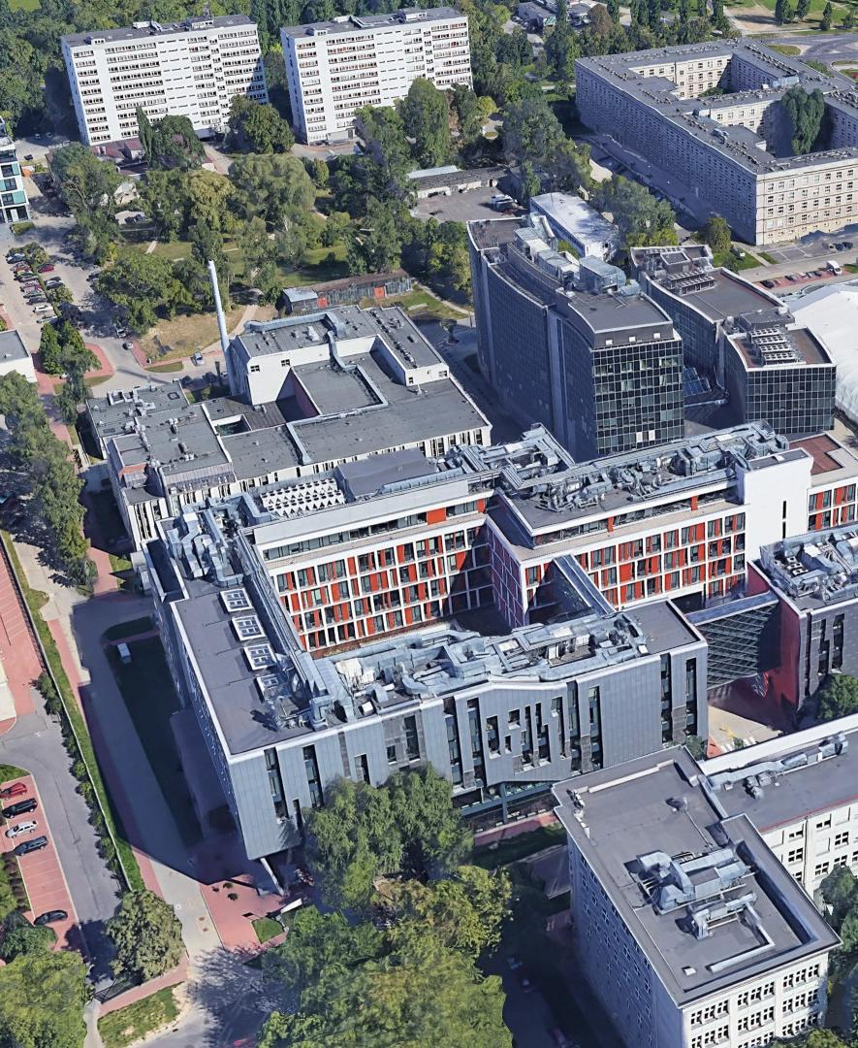
Venue & Destination: Warsaw, Poland
Warsaw is one of Central Europe’s most accessible capitals, with excellent air and rail connections and a city centre located only 20 minutes from Warsaw Chopin Airport.
Proposed venue: Faculty of Physics and Faculty of Psychology, University of Warsaw (Ochota Campus)
Facilities
Large auditoria for plenary sessions
Multiple lecture halls for parallel sessions
Spacious areas for posters, exhibitions, and networking
Modern audiovisual infrastructure and technical support
Possibility of online participation
Why Warsaw?
Dynamic European capital combining rich history, culture, and modern infrastructure
Strong traditions in geodesy, geomagnetism, and geophysics
Home to renowned scientists such as Nicolaus Copernicus and Maria
Skłodowska-Curie
Active contributor to international geodetic, geomagnetic, and space research
Vibrant scientific environment with numerous research institutes located on the Ochota Campus
Scientific Heritage
Poland hosts advanced geodetic and geomagnetic infrastructure, including
ASG-EUPOS, INTERMAGNET observatories, a Satellite Laser Ranging station
and internationally recognized geophysical research facilities.

Slide 5
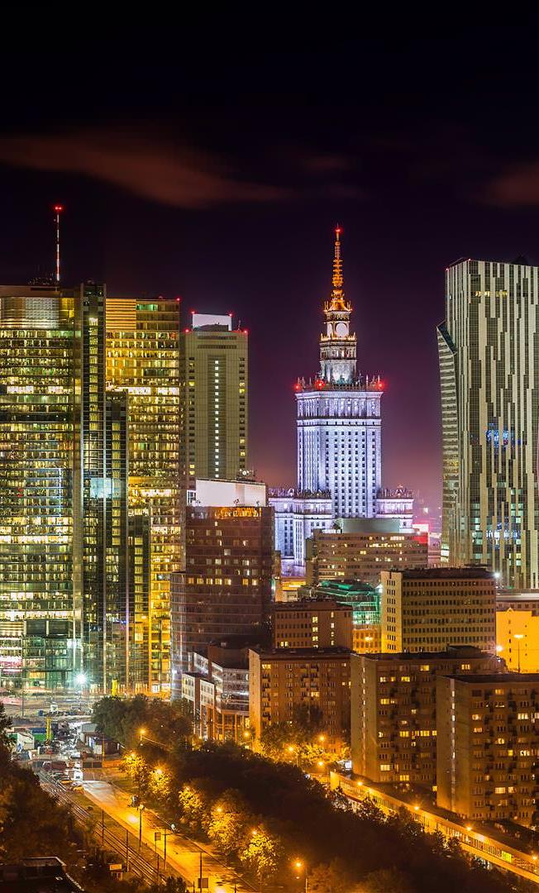
Climate & other practicalities
Climate (August): Pleasant summer weather, typically 19–25°C, with occasional rain.
Easy access: Direct international flights to Warsaw Chopin Airport; convenient transport by taxi, ride-share, and public transport.
Visas: Invitation letters provided; full support for visa applications in line with the ISC Principle of Universality.
Payments: Polish złoty (PLN): 1 EUR = approx. 4.2 PLN; credit cards and contactless payments widely accepted.
Accommodation: Broad range of hotels (approx. 60–180 EUR/night) within 3 km of the venue, plus affordable student housing and budget options (20–50 EUR/night).
Dining: Campus cafeterias, food trucks, lunch options, and numerous restaurants in central Warsaw.

Slide 6

Financial support
Financial support for the conference will be sought from national funding schemes, including programs of the Polish Ministry of Science and Higher Education (MNiSW), subject to availability at the time of the event.
Local support will be explored in cooperation with the Warsaw Convention Bureau and relevant city initiatives promoting Warsaw as a host city for international scientific meetings.
Additional sponsorship is expected from industry partners, including companies in geophysics, geospatial technologies, instrumentation, and scientific publishing, through a dedicated sponsorship and exhibition program to be developed during the preparation phase.

Slide 7
Financial aspects & Registration Fees
The Local Organizing Committee (LOC) will be fully responsible for the financial management of the Scientific Assembly. Resources for the preparation phase have been secured, and additional governmental, industrial, and commercial support will be sought to minimize participation costs. A transparent budget will ensure financial sustainability and broad accessibility.
Indicative registration fees (incl. 23% VAT):
Early Bird IAG Member: EUR 450
Early Bird Non Member: EUR 500
Students: EUR 290–360
10% discount for individual IAG members
Registration fee includes:
Access to all scientific sessions
Access to the exhibition and poster area
Meeting materials
Coffee breaks
Opening Ceremony
Welcome Reception
Estimated daily costs:
Accommodation: EUR 60–150
Meals: EUR 20–40
Local transport: EUR 3–5
Income/Registered Delegates | gross price in EUR | % | 1000 pers./net | 1200 pers./net
IAG Member registration fees
Member - early fee | 450,00 | 15% | 54878,05 | 65853,66
Member- standard fee | 540,00 | 5% | 21951,22 | 26341,46
Non Member registration fees
Non-Member - early fee | 500,00 | 45% | 182926,83 | 219512,20
Non-Member- standard fee | 600,00 | 5% | 24390,24 | 29268,29
Student Member registration fees
Student Member early fee | 290,00 | 10% | 23577,24 | 28292,68
Student Member - standard fee | 330,00 | 3% | 8048,78 | 9658,54
Student Non- Member registration fees
Student Non-Member early fee | 320,00 | 8% | 20813,01 | 24975,61
Student - Non-Member standard fee | 360,00 | 4% | 11707,32 | 14048,78
Speakers, Staff (no fee) |  | 5%
Retired and accompanying persons fee TBD |  |  | 348292,68 | 417951,22
Abstract Submission fee | 40,00 | 80% | 26016,26 | 31219,51
Sponsorship & Exhibition Income |  |  | 20000,00 | 20000,00
TOTAL INCOME |  | EUR | 394308,94 | 469170,73

Slide 8
Preliminary budget
This preliminary financial plan is based on two possible attendance scenarios: 1,000 and 1,200 people. Accordingly, the financial plan has been carefully designed to ensure financial stability in both cases. All prices are listed in EUR and are estimates based on registration fees from previous events. Since the event is planned for 2029, actual registration fees and related costs may be approximately 10–15% higher due to inflation and rising operating costs.
Expenses |  |  | 1000 pers./net. | 1200 pers./net
Fixed costs
Website |  |  | 7600,00 | 7600,00
Sponsorship management & Exhibition management |  |  | 8500,00 | 8500,00
Promotion & Advertising |  |  | 4275,00 | 4275,00
Poster session |  |  | 8540,00 | 8540,00
Venue rental + logistics |  |  | 85500,00 | 85500,00
Additional AV equipment and technical support |  |  | 7500,00 | 7500,00
Venue branding |  |  | 8000,00 | 8000,00
Healthcare |  |  | 2000,00 | 2000,00
Contingency |  |  | 5000,00 | 5000,00
PCO Project Management |  |  | 40000,00 | 40000,00
IAGA head tax |  |  | 15000,00 | 18000,00
TOTAL FIXED COSTS |  |  | 191915,00 | 194915,00
Variable costs
Registraton and registration on-site |  |  | 19025,00 | 19725,00
Financial services and bookkeeping |  |  | 11347,00 | 13546,40
Delegates congress materials package |  |  | 21500,00 | 22000,00
Abstract management |  |  | 8750,00 | 10150,00
Catering services at the venue ( Welcome Reception, coffee breaks) |  |  | 133400,00 | 140200,00
TOTAL VARIABLE COSTS |  |  | 194022,00 | 205621,40
TOTAL EXPENSES |  |  | 385937,00 | 400536,40

Slide 9
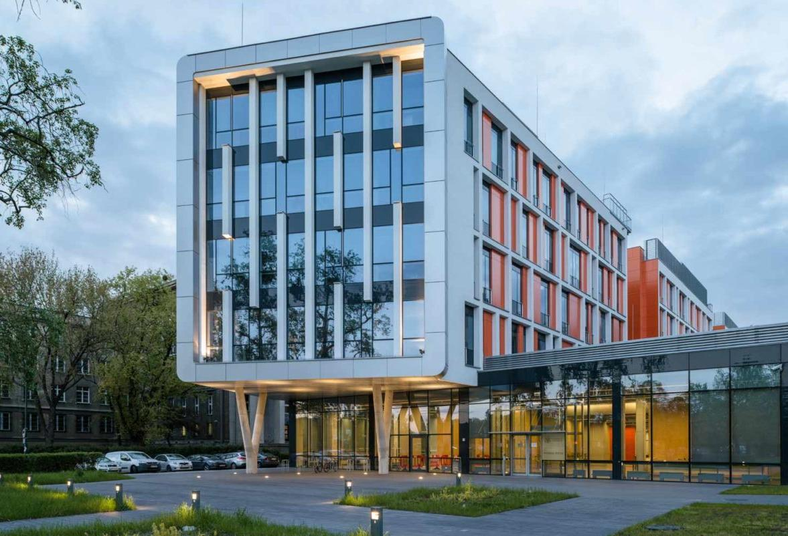
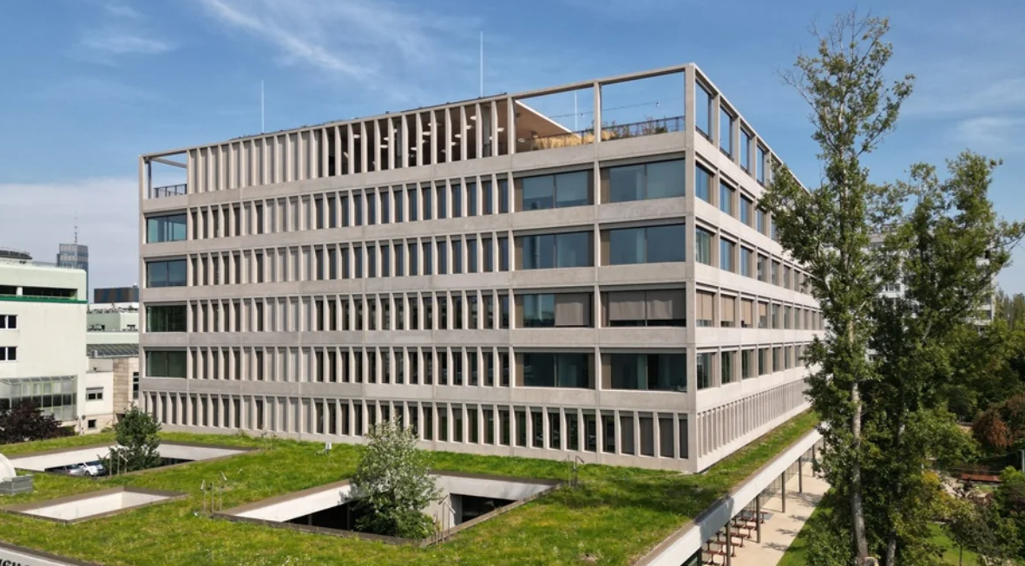
Proposed Venue
FACULTIES OF PHYSICS
AND OF PSYCHOLOGY
UNIVERSITY OF WARSAW

Slide 10
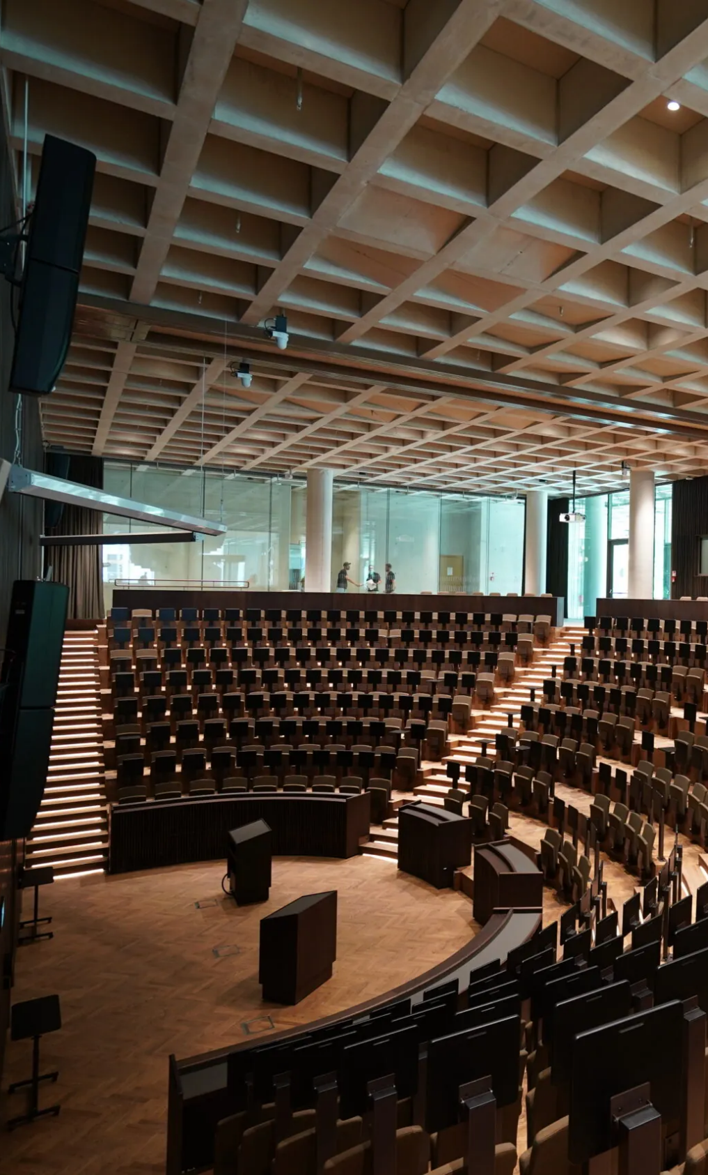
Conference Facilities & Organization
Venue: Faculties of Physics and Psychology, University of Warsaw (Banach/Ochota Campus), a major scientific hub with experience hosting international conferences.
Facilities: Lecture halls for 20–500 participants, poster and exhibition areas, meeting rooms, organizer offices, modern AV systems
and high-speed internet supporting hybrid participation.
Accessibility: Located 10–15 min from Warsaw city center and 15–20 min from Warsaw Chopin Airport.
Accommodation: Wide range of hotels and budget options within
10–30 min of the venue.
Conference Services: Dedicated online platform for registration and abstract submission, supported by experienced professional conference organizers (PCO).
Outreach: Public lectures and engagement activities planned alongside the scientific program.

Slide 11
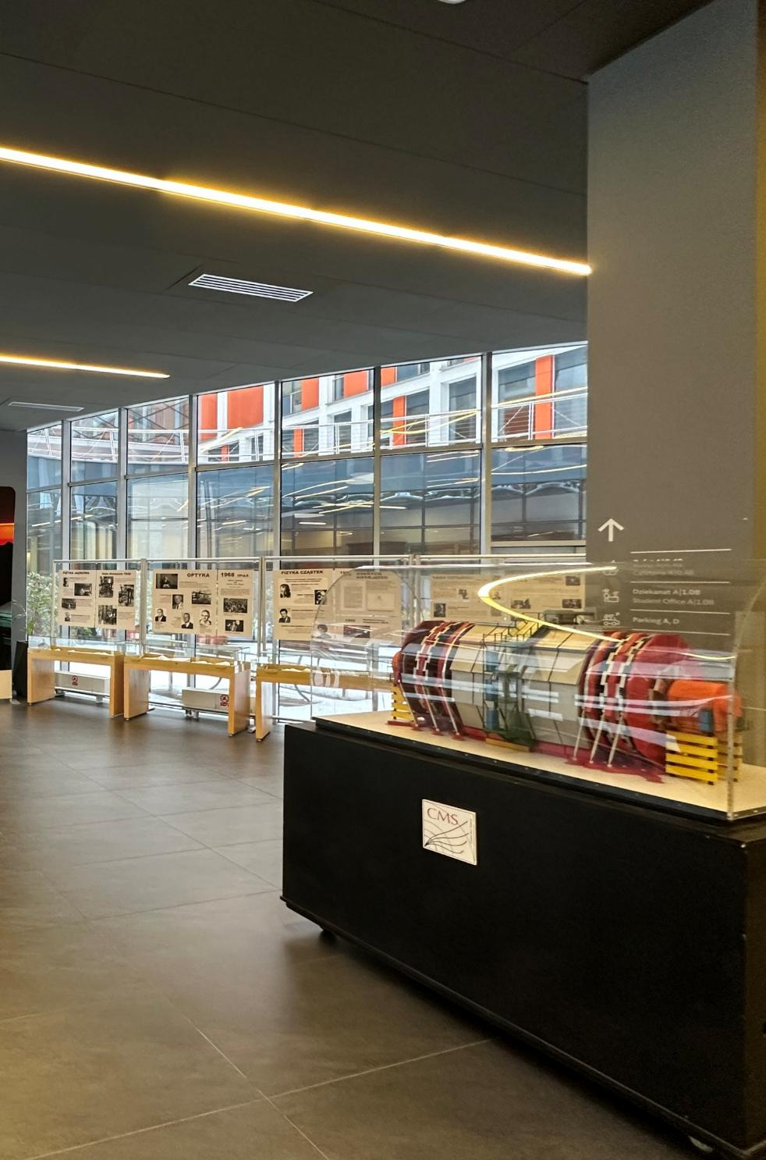
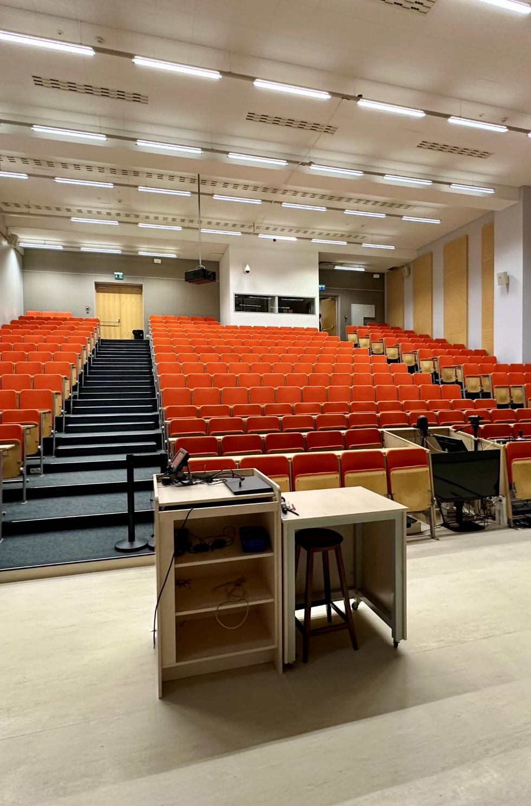
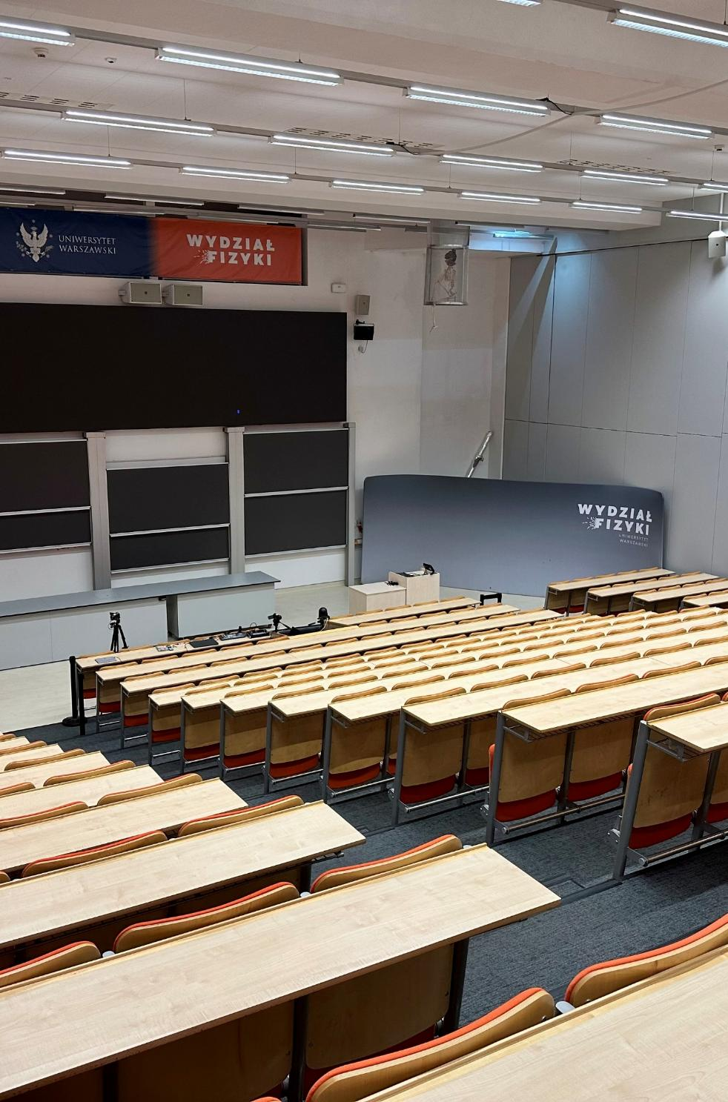
FACULTY OF PCHYSICS
FACULTY OF PHYSICS
Warsaw

Slide 12
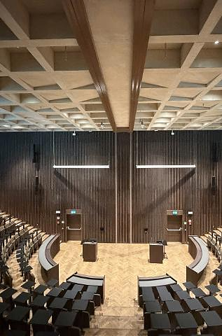
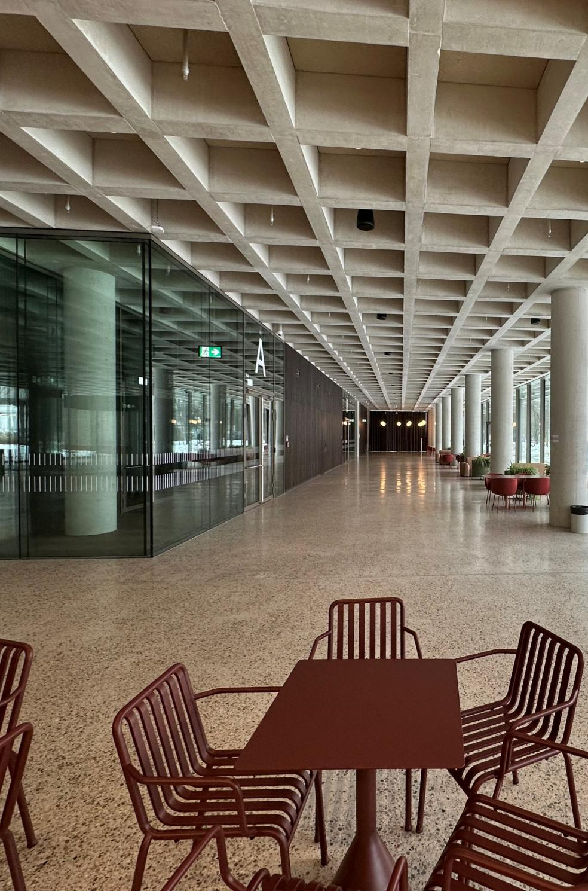
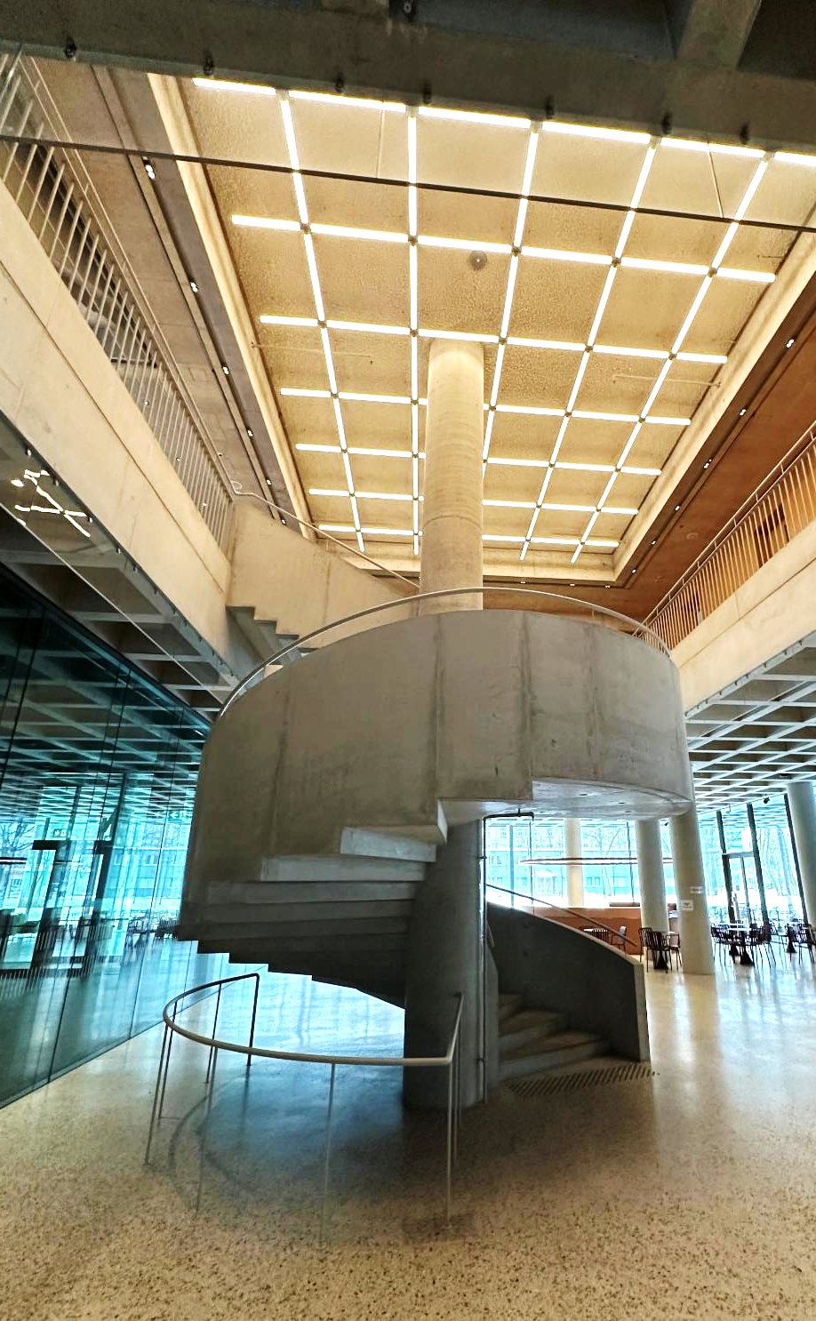
FACULTY OF PSYCHOLOGY
Warsaw

Slide 13
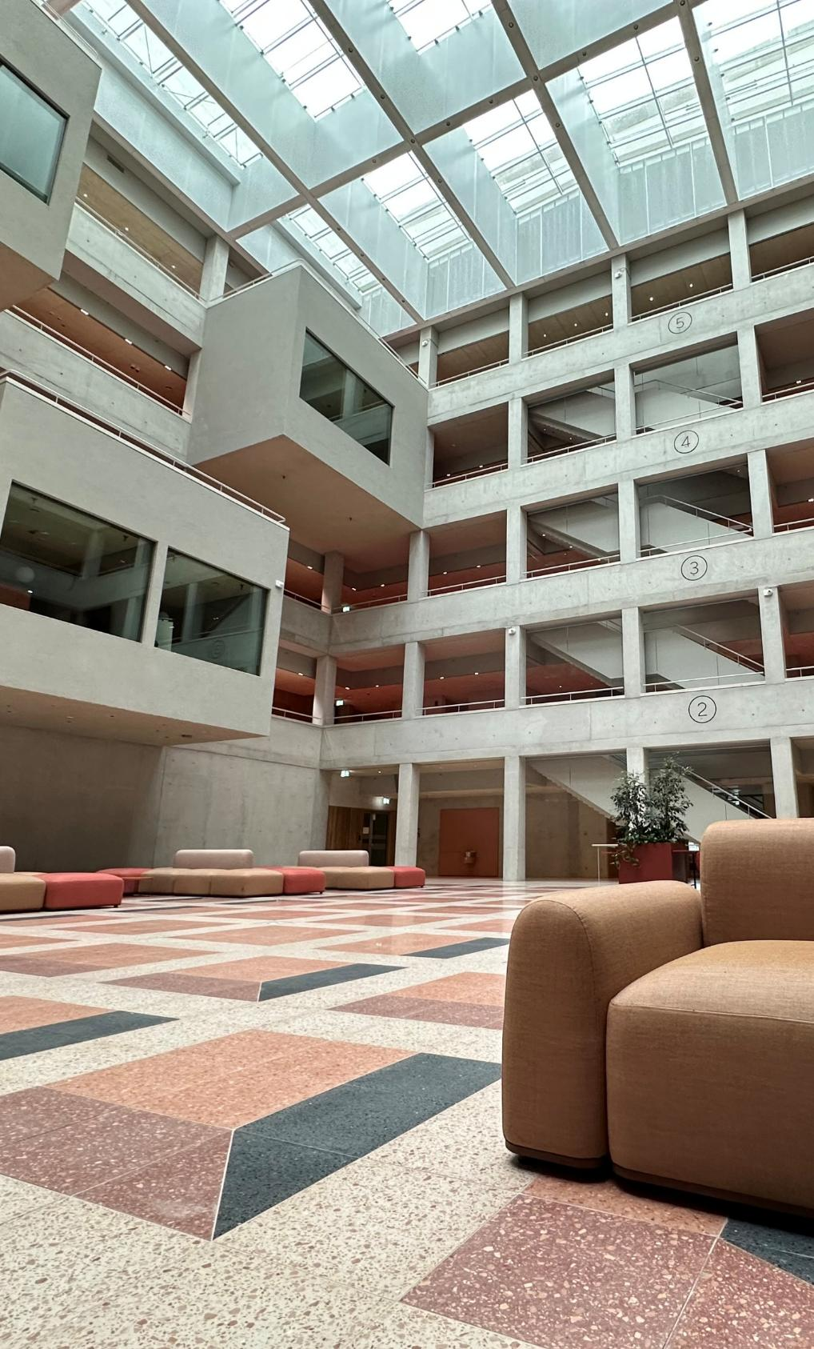
Conference Venue
FACULTY OF PHYSICS BUILDING
Room | Capacity | Purpose
Auditorium (level 0) | 500 (divided 300 &200) | Opening Ceremony, Plenary Lectures, General Assembly, Lecture Hall
Room 0.06 (level 0) | 150 | Lecture hall
Room 1.40 (level +1) | 110 | Lecture hall
Room 1.01 (level +1) | 100 | Lecture Hall
1.02 (level +1) | 60 | Lecture Hall
1.03 (level +1) | 60 | Lecture Hall
17 small rooms | 15-30 | Lecture halls
foyer (level 0) |  | Reception / coffee breaks
foyer B (level 0) |  | Exhibition / coffee breaks
foyer (level +1) |  | posters (see room layout plans)
FACULTY OF PSYCHOLOGY BUILDING
Room | Capacity | Purpose
Aula A + B | 360 (divided 180 & 180) | Lecture hall
Room 02.01 | 120 | Lecture hall
Room 03.01 | 120 | Lecture hall
10 small rooms | 15-30 | Lecture halls
Foyer |  | Welcome Reception / coffee breaks
Atrium |  | Exhibition

Slide 14
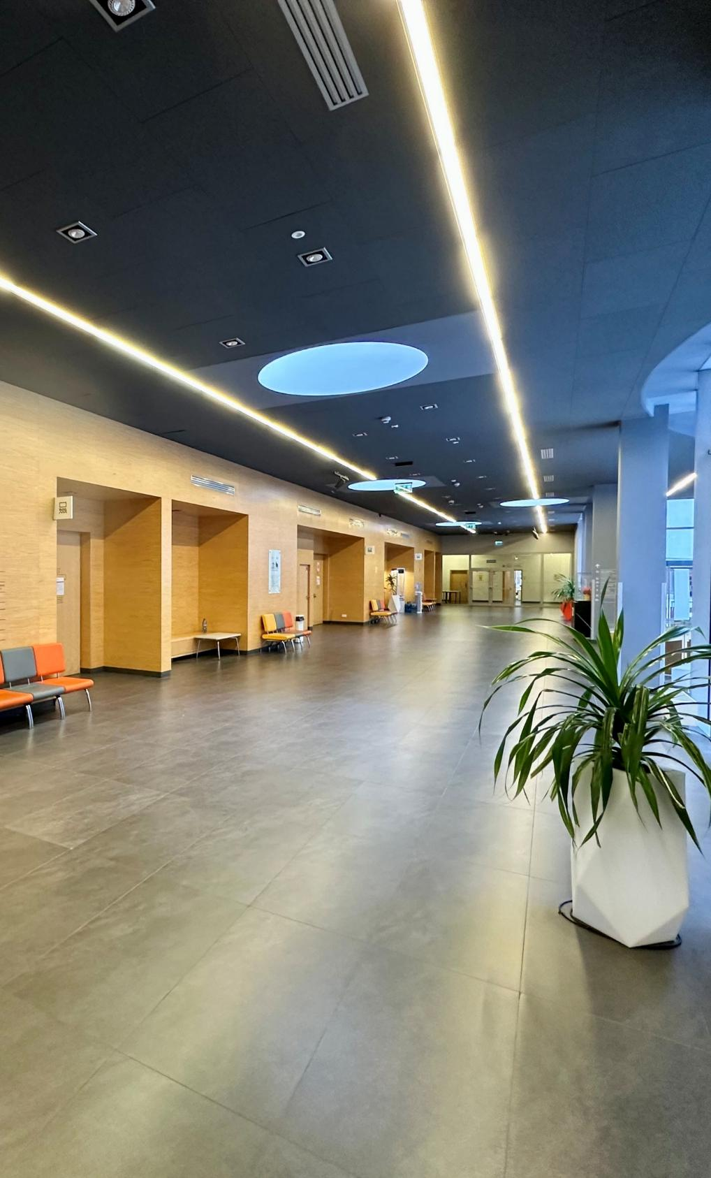
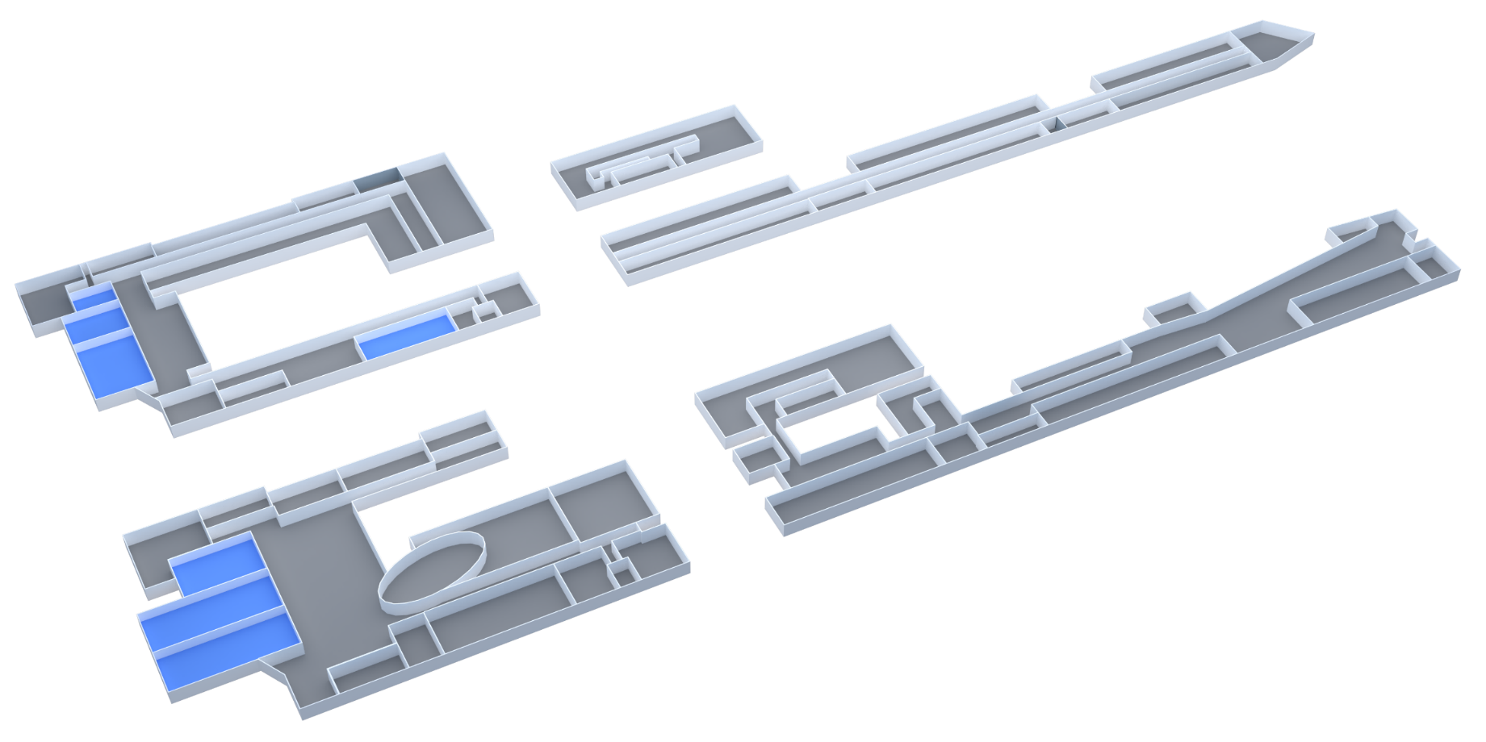
Venue Plan – Faculty of Physics
Level +1
1.03
Catering
Area
1.02
Poster
Area
1.40
1.01
Level 0
Exhibition
Area
& Coffee Breaks
0.06
Auditorium
Auditorium
Registration
https://en.uw.edu.pl/

Slide 15
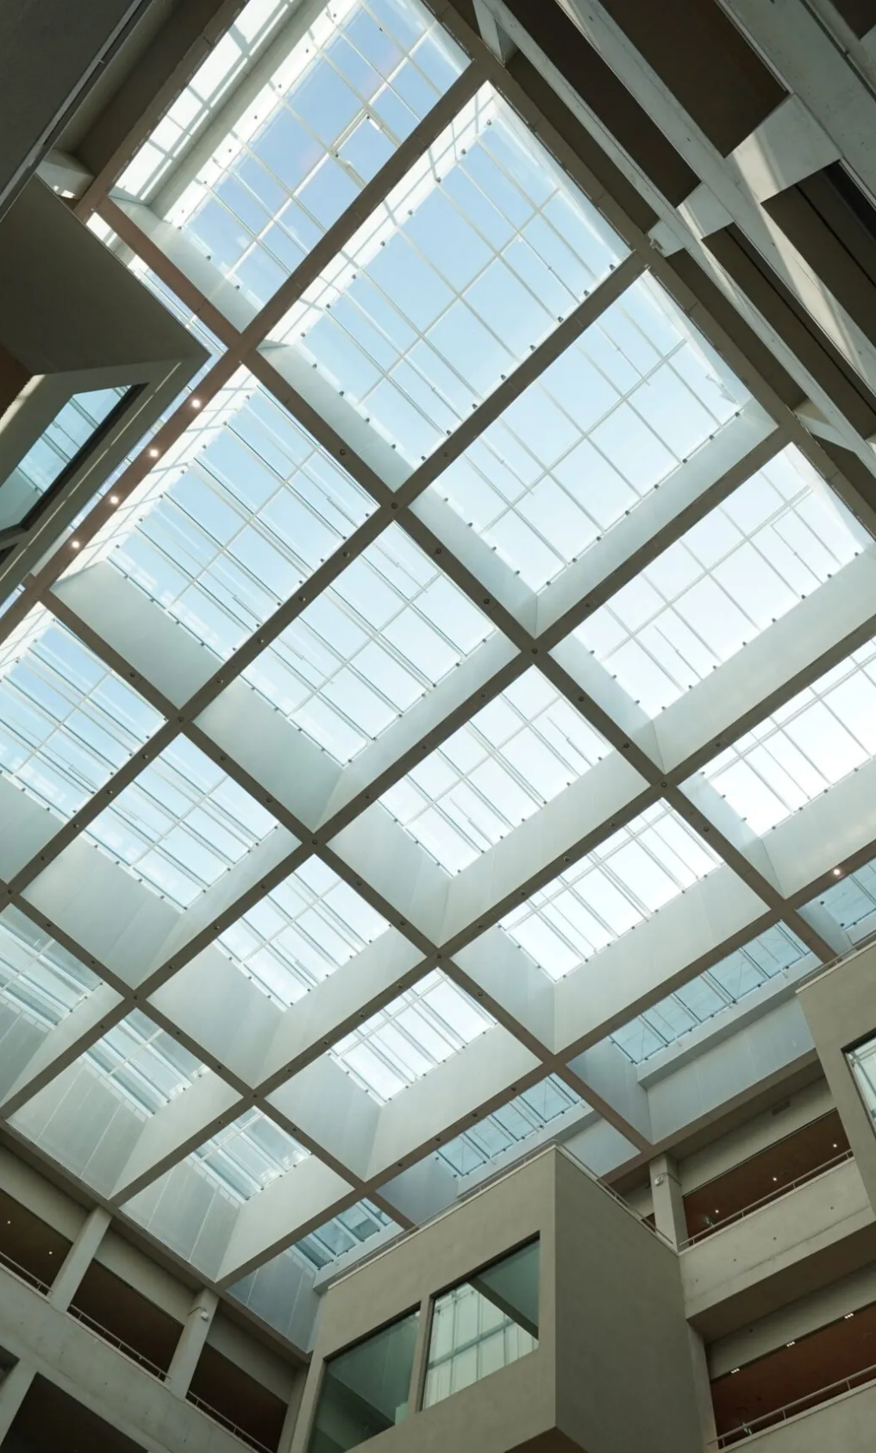
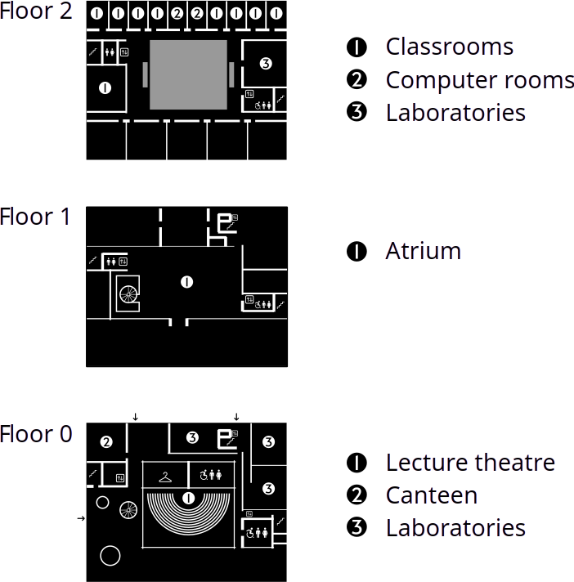
Venue Plan – Faculty of Psychology
https://psych.uw.edu.pl/

Slide 16

Social Events
Icebreaker
An informal icebreaker will be held on the first day of on-site registration at Banacha Campus, with refreshments and networking opportunities. Indoor spaces are available in case of bad weather.
Reception after Opening Ceremony
A reception with drinks and finger food can be organized in campus lobbies, allowing participants to mingle after the Opening Ceremony.
Conference Dinners (IAG & IAGA)
Dinners can be hosted in nearby Warsaw venues.
Both combined and separate formats are feasible, with transport provided if off-campus.
Other Social Events
Smaller events for Early Career Scientists and thematic networking sessions can be arranged on campus or in Warsaw, including cultural outings and informal meetups.

Slide 17
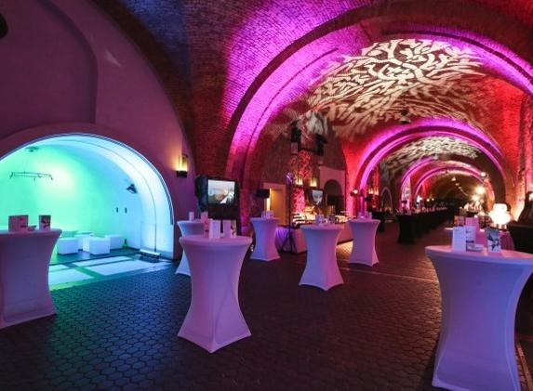
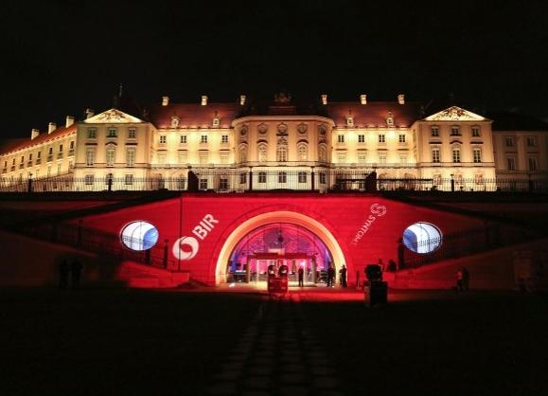
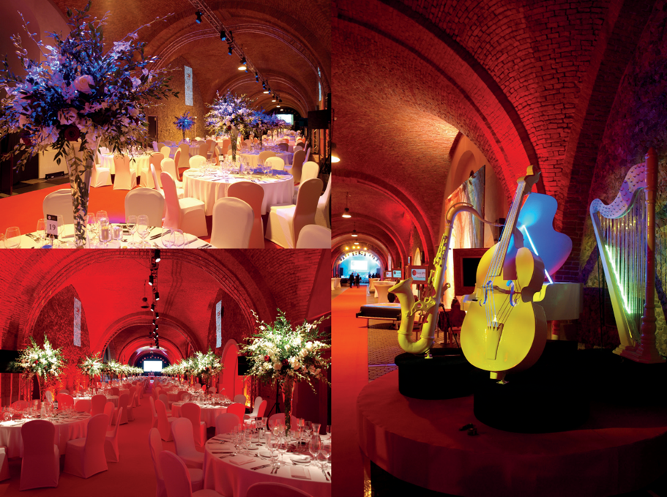
Kubicki Arcades
(Royal Castle) - option 1
A symbol of the centuries-long traditions and ceremonial heritage of the Polish–Lithuanian Commonwealth and the Republic of Poland, the Royal Castle in Warsaw offers a distinguished and elegant setting for the Conference Gala Dinner. The Kubicki Arcades, with their refined architectural character and unique atmosphere, provide an exceptional venue for a formal evening event. Overlooking landscaped gardens and the Vistula River, this historic space will create a memorable and prestigious backdrop for an unforgettable gathering.

Slide 18
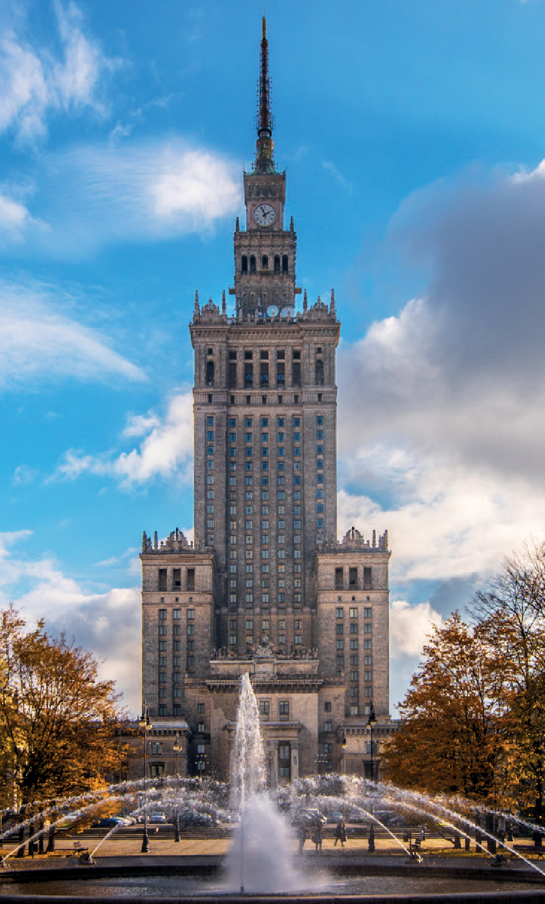
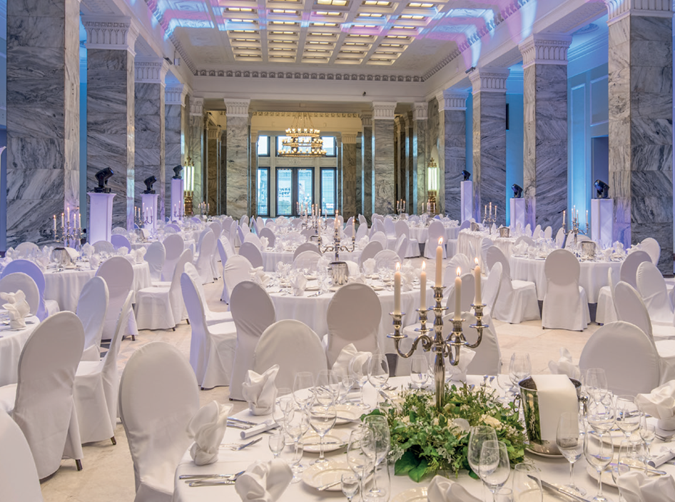
Palace of Culture
and Science – option 2
The Palace of Culture and Science, one of Warsaw’s most recognizable landmarks, offers a prestigious and distinctive setting for the Conference Gala Dinner. As an architectural icon dominating the city skyline, it combines monumental interiors with panoramic views over the capital. Hosting the gala in this historic venue will provide participants with an elegant atmosphere and a unique perspective on Warsaw, creating a memorable highlight of the conference program.

Slide 19
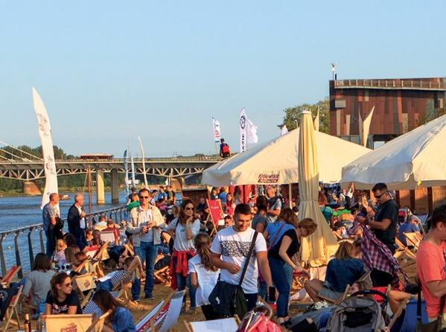
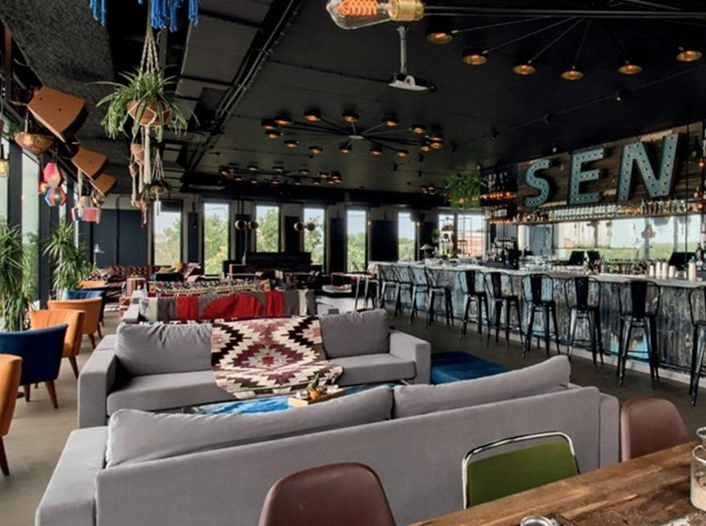
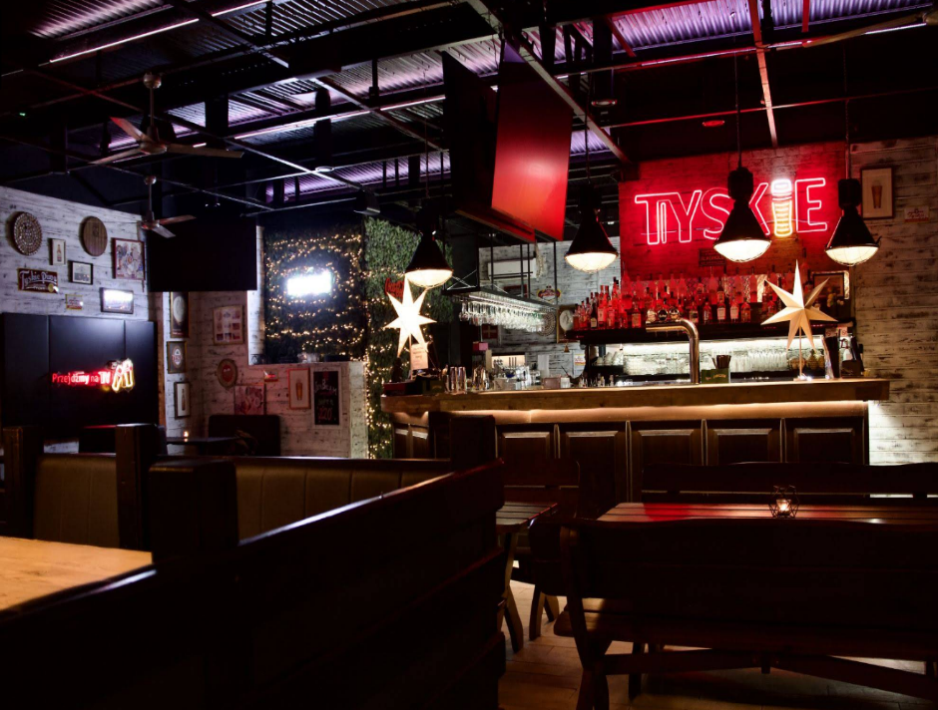
Students Party
Possible Locations
Monta Beach
Volley Club
SEN Club
on the Vistula River
Bolek
Pub & Restaurant

Slide 20

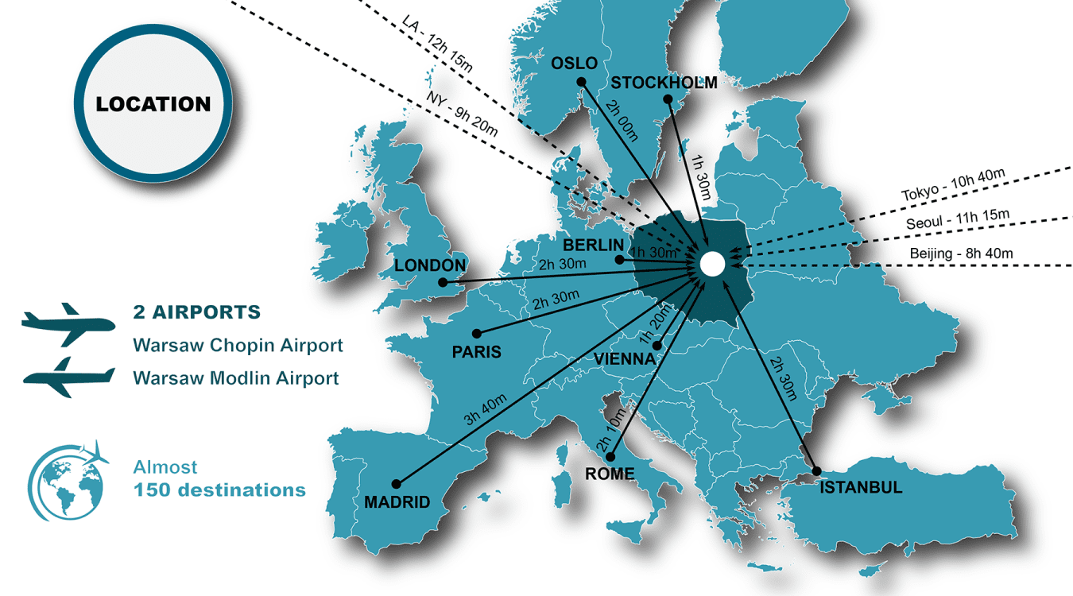
Location
and Flight connection
Warsaw, the capital of Poland, is served by two airports: Warsaw Chopin Airport (WAW), the main international hub located about 10 km from the city centre, and Warsaw Modlin Airport (WMI), about 35 km away, mainly serving low-cost airlines.
Warszawa Centralna railway station, located in the city centre, is a major national and international transport hub. It is well connected by metro, suburban trains, trams, and buses, providing easy access across Warsaw and the surrounding region.

Slide 21

Hotel Inventory
Property | Category | Distance from Venue | Estimated Rate (per night)
Warsaw Presidential Hotel | ★★★★★ | 2.8 km | €142–€214
Crowne Plaza Warsaw – The Hub (IHG) | ★★★★ | 2.3 km | €119–€131
Radisson Blu Sobieski | ★★★★ | 1.7 km | €71–€95
Holiday Inn Warsaw City Centre (IHG) | ★★★★ | 2.5 km | €71–€95
Novotel Warszawa Airport | ★★★★ | 2.8 km | €83–€107
Golden Tulip Warsaw Centre | ★★★★ | 1.9 km | €71–€100
Hampton by Hilton Warsaw Reduta | ★★★ | 2.9 km | €95–€119
ibis Warszawa West Station | ★★★ | 1.5 km | €59–€83
Campanile Warszawa | ★★★ | 1.9 km | €47–€71
ibis budget Warszawa Reduta | ★★ | 1.5 km | €43–€66
Hotel Premiere Classe Warszawa | ★★ | 2.0 km | €43–€62
University Residence No. 2 (UW) | — | 450 m | €40–€50
University Residence No. 5 “Smyczkowa” (UW) | — | 7.4 km | €40–€50
AB Hostel | — | 1.7 km | €40–€50
PASTEL Guest Rooms | — | 1.4 km | €40–€50
The Banach campus is located in one of Warsaw’s main academic districts, with numerous student dormitories situated within walking distance and providing substantial accommodation capacity during the academic year and summer period.

Slide 22

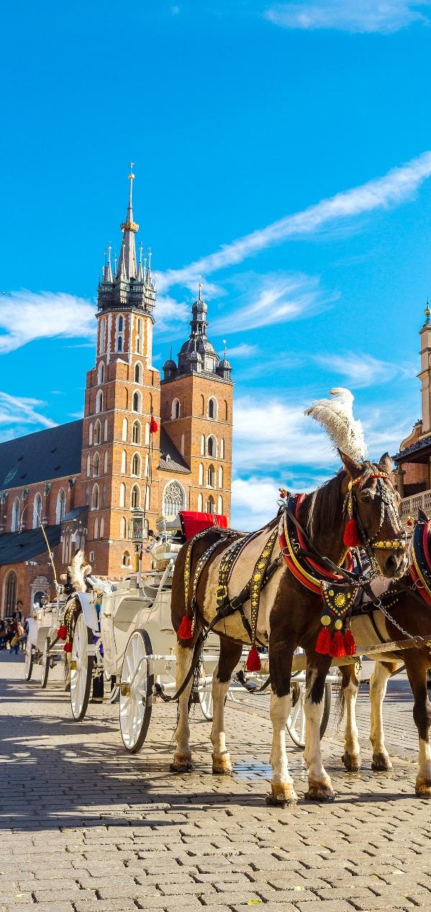
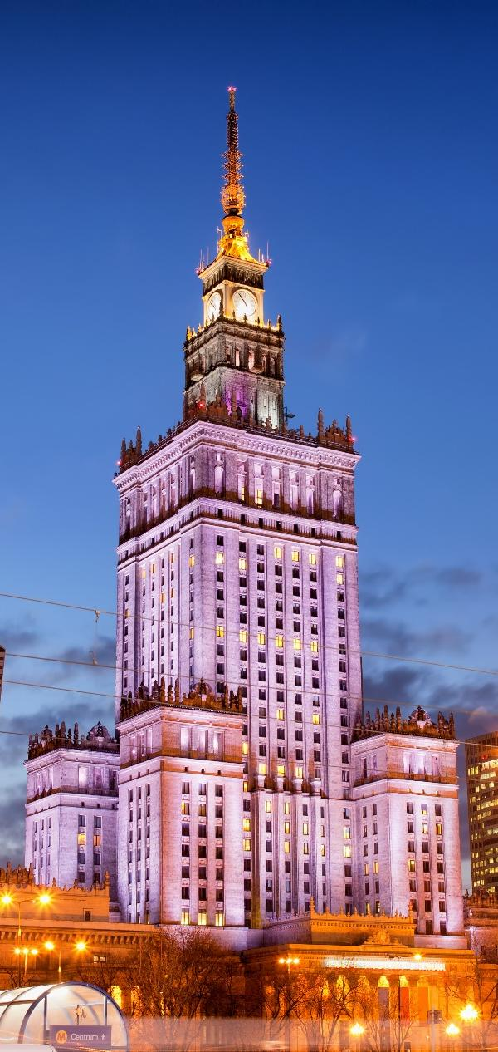
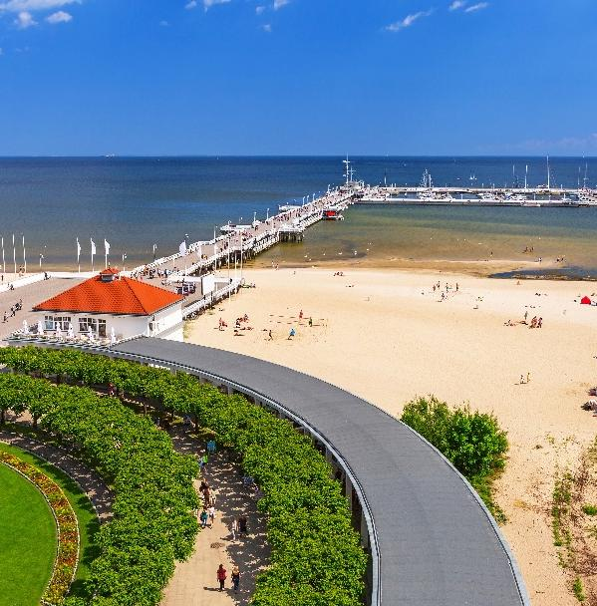
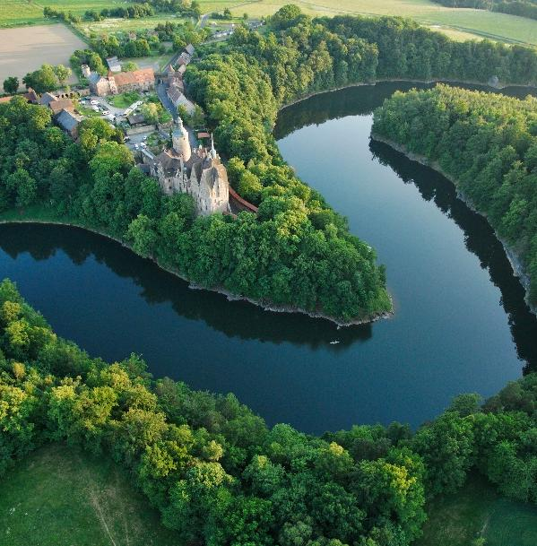

Slide 23
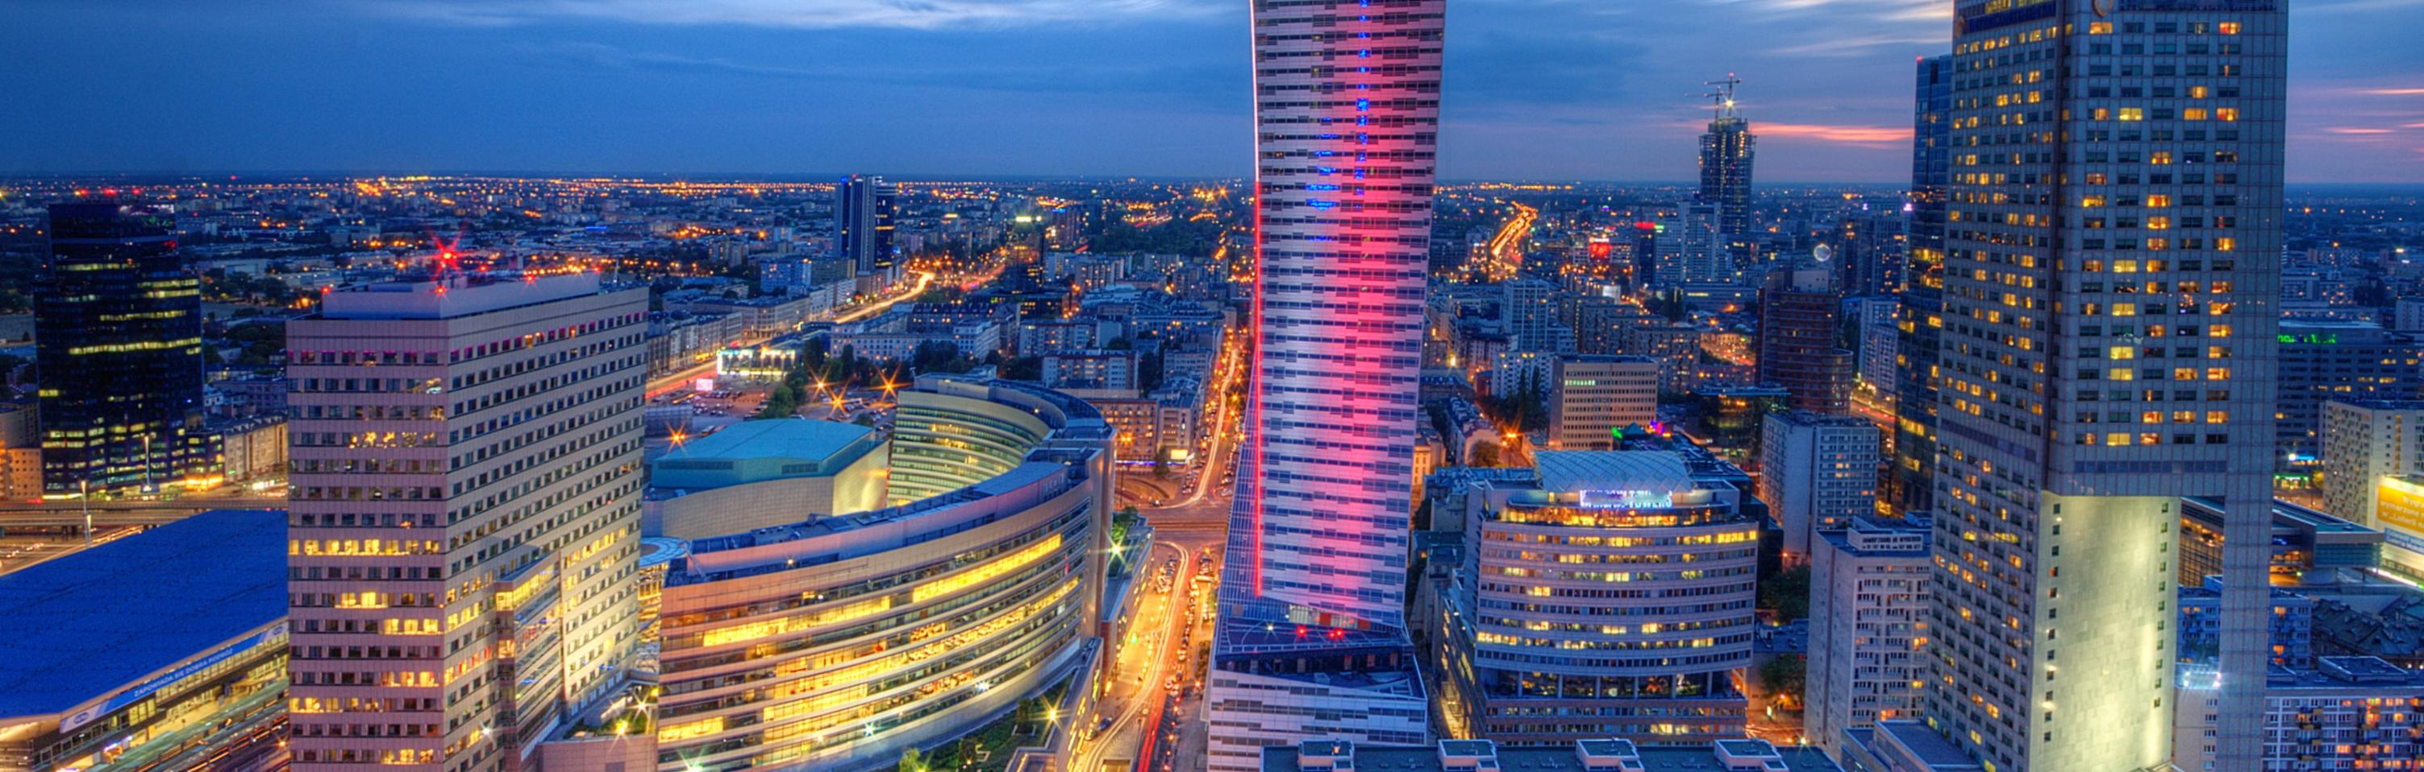
Contact us
Dr hab. Anne Neska, Assiociate Professor
Department of Magnetism
Belsk Observatory
Instytut Geofizyki Polskiej Akademii Nauk
anne@igf.edu.pl
Prof. Paweł Wielgosz
Department of Geotechnical Engineering
University of Warmia and Mazury
in Olsztyn
pawel.wielgosz@uwm.edu.pl
Oksana Sylwester
PCO
Mazurkas Congress Management
kongresy@mazurkas.com.pl

