Slide 1
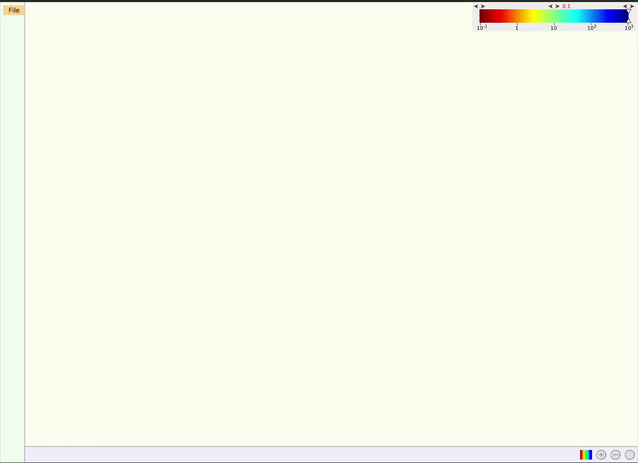
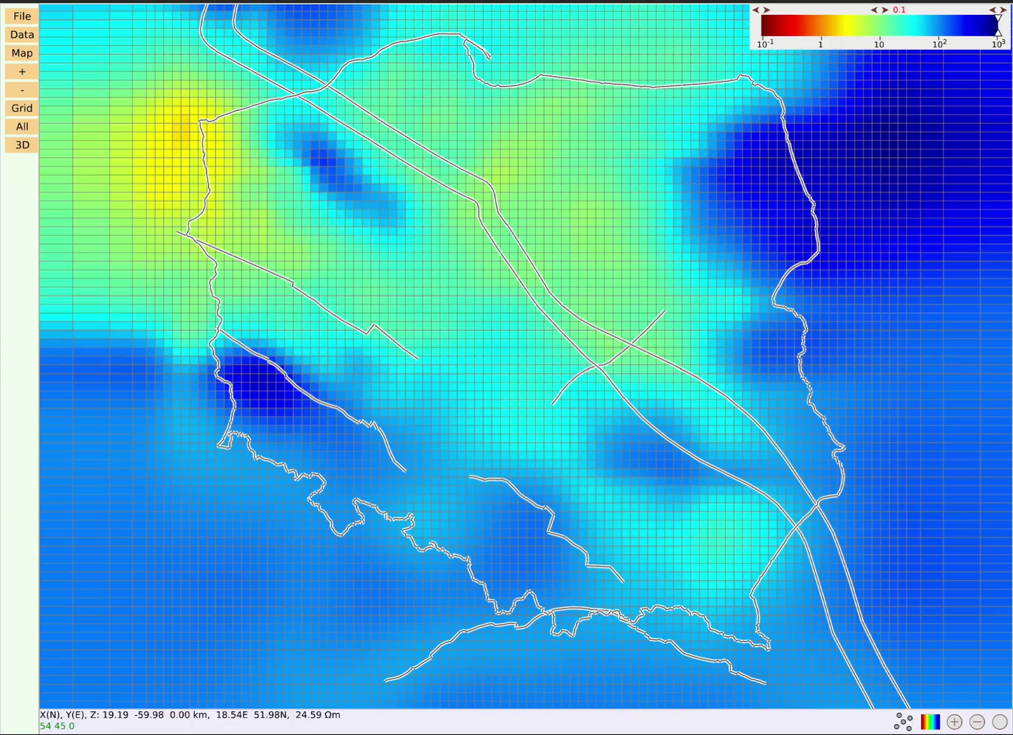
3D magnetotelluric models are three-dimensional grids where cells have resistivity values in Ωm displayed as colours.
Making key features of such a model visible is a demanding task.
We are incorporating a web-based, interactive visualization software to the EPOS Portal via a distributed service.
Below some examples of its functionality with a model of Poland.
Opening files
Scrolling vertically through grid layers

Slide 2
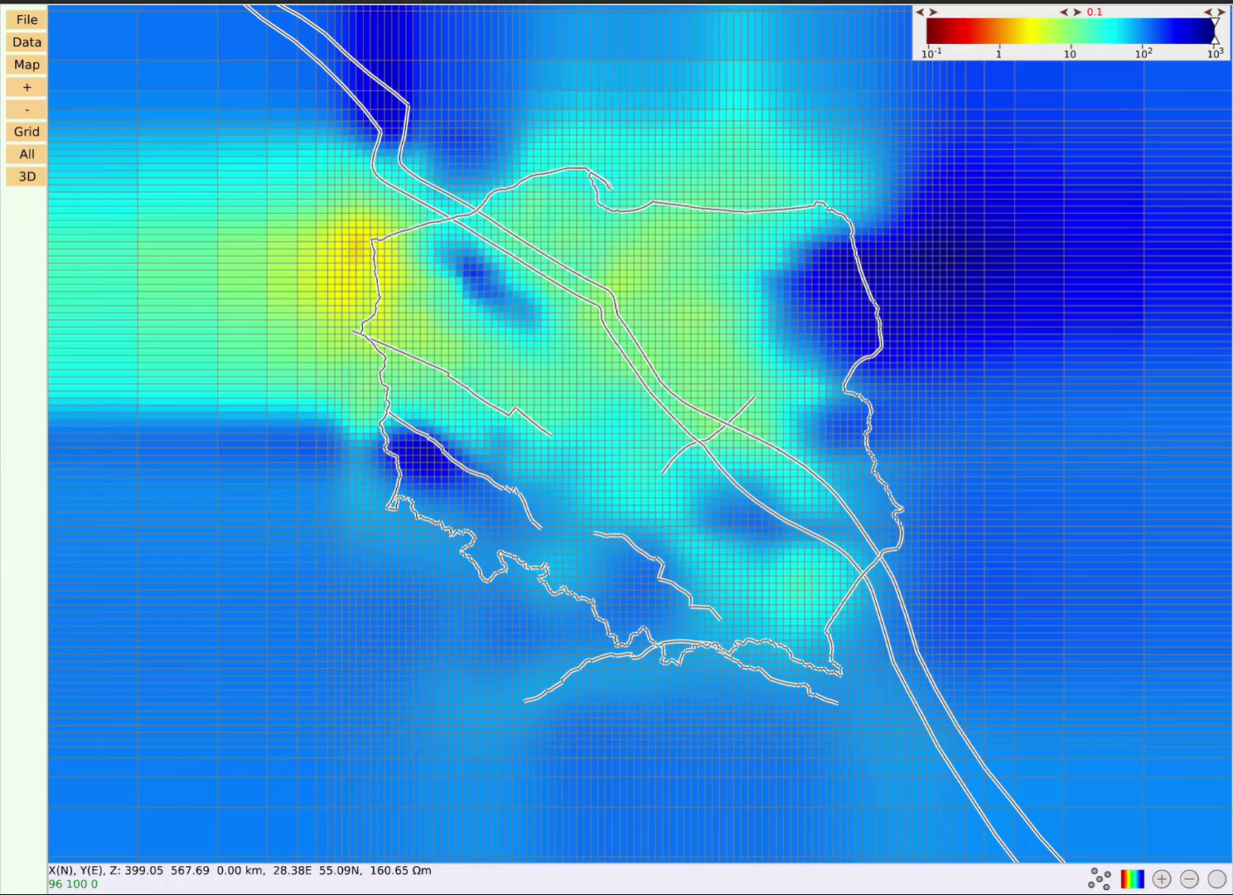
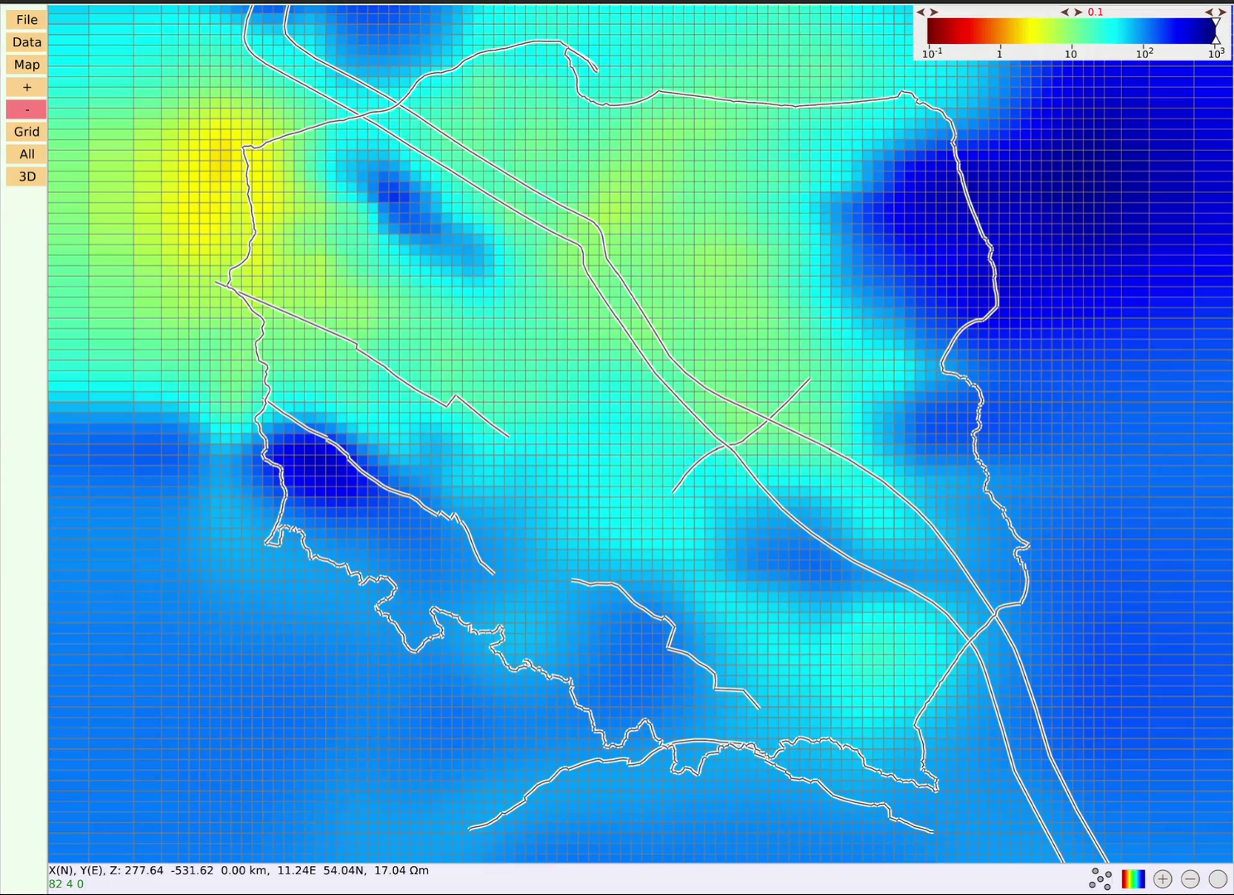
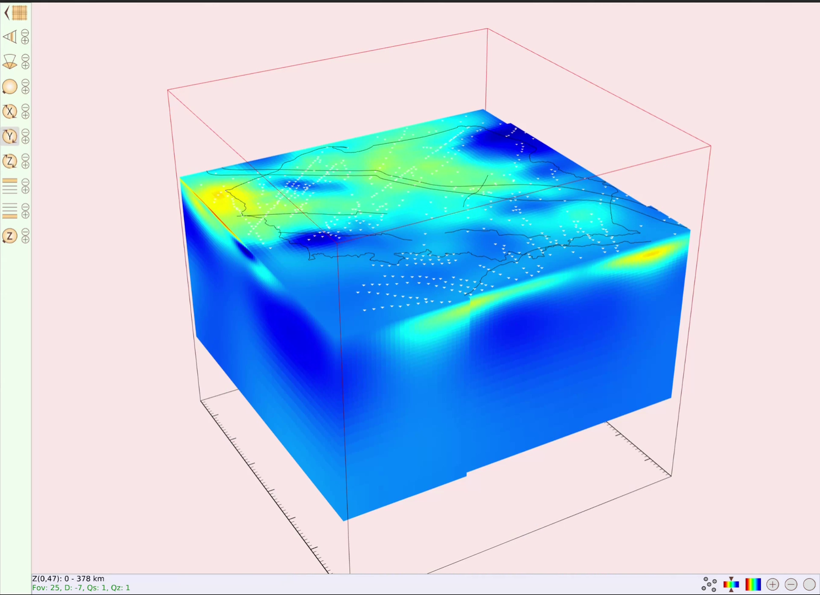
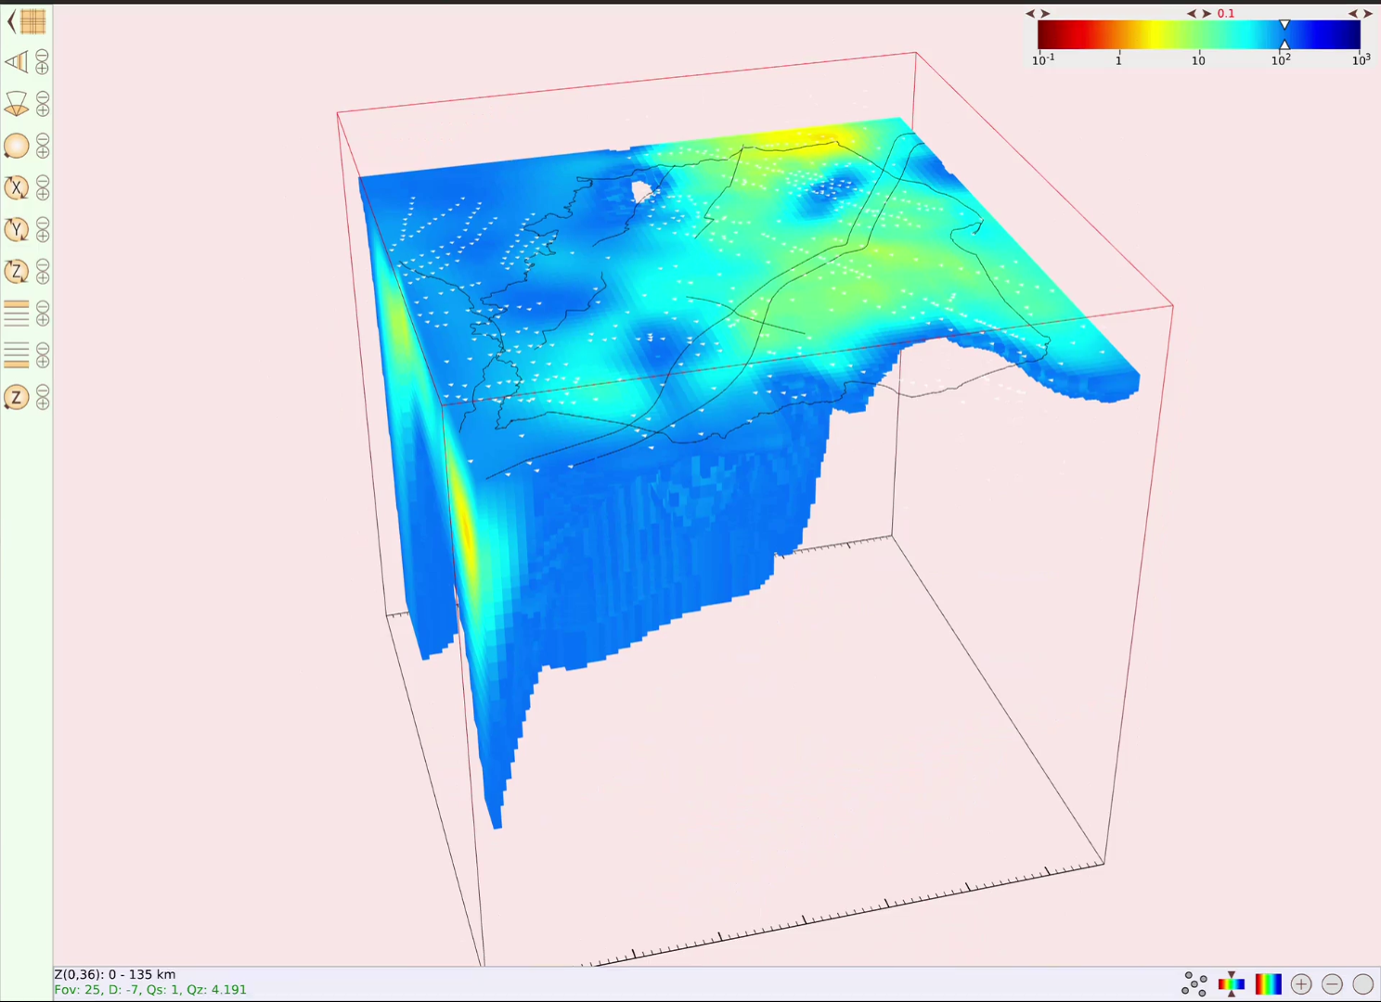
Map view – zooming in
Adding/removing grid lines/stations
3D view – turning around
Reducing visibility to lower resistivities

Slide 3
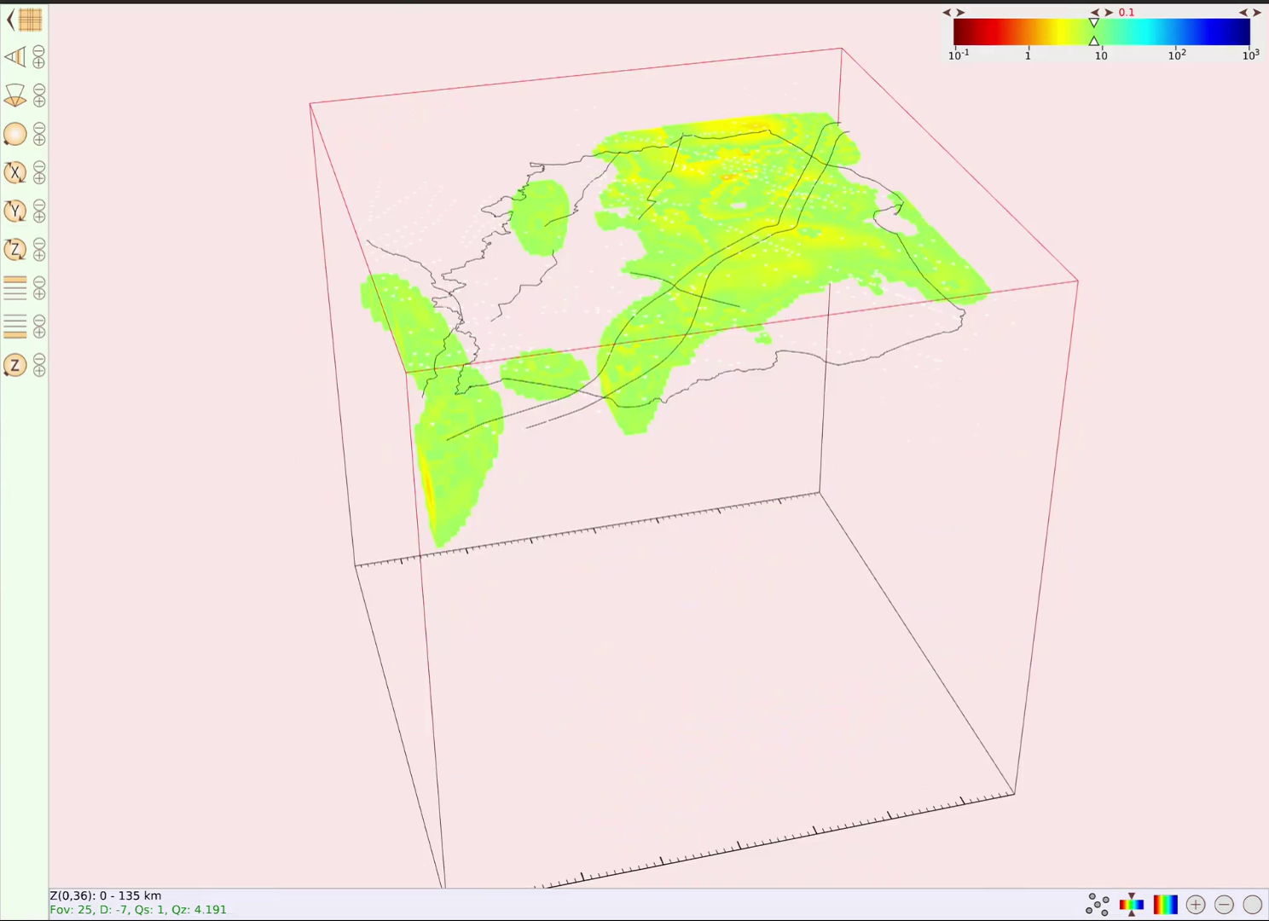
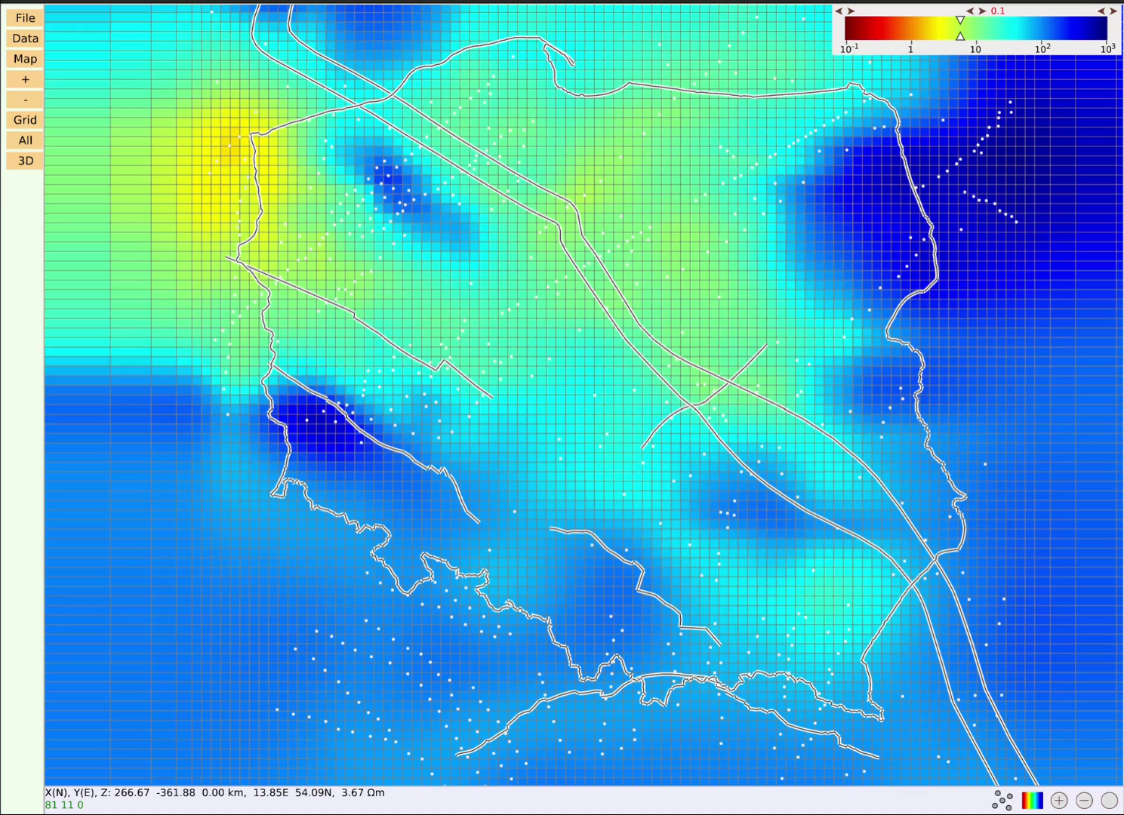
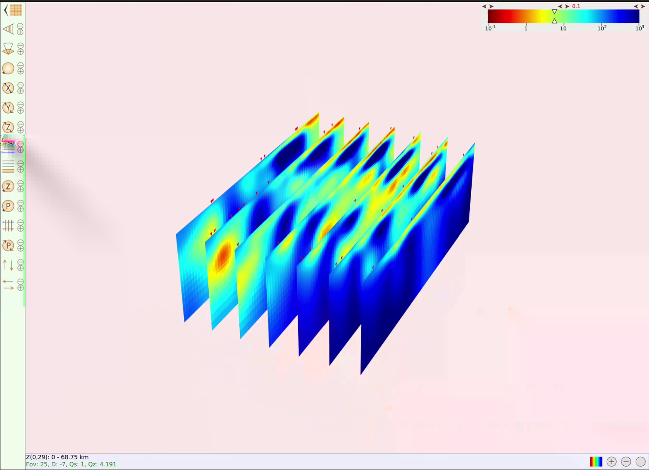
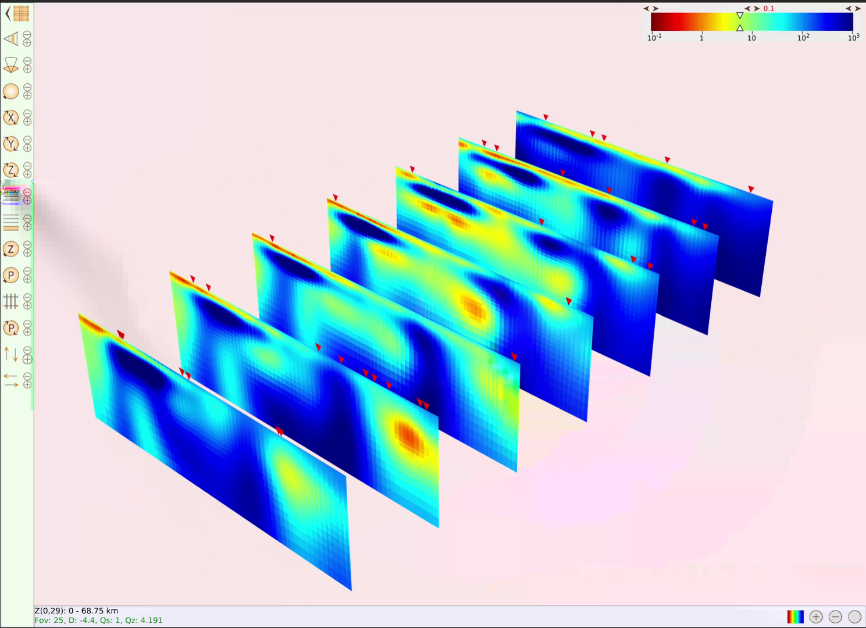
3D view on low resistivity zones
Defining profiles on map for section view
Section view – adjusting distance
Section view – adjusting lateral extent

